Slide 1
Questions for UCR
indicators look a lot like Queen’s - faculty buy-in? Are the indicators the priorities of the program?
a huge number of courses listed as assessing attributes- are they all assessing and providing information for analysis and reporting?
Primary focus should be planning assessment, working with instructors
Student survey results

Slide 2

UNIVERSITY OF COSTA RICA
Outcomes assessment for program improvement
Brian Frank
http://bit.ly/UCR-EGAD

Slide 3
Sessions
Day 1
Big Picture: Overview
Goals, questions, and outcomes – working time
Curriculum mapping and assessment – working time
Day 2
Analysis and interpretation – Case study
Processes and planning - Discussion

Slide 4
Administrative issues
Slides and summary handout will be posted to EGAD website http://egad.engineering.queensu.ca. Direct link to this material is:
Other support and resources will described at the end.
NOTE: These two days will be active and collaborative workshops - feel free to ask questions or comment throughout.
This first session will probably be the least active.
http://bit.ly/UCR-EGAD

Slide 5
References
J. Biggs, Teaching for Quality Learning
Overall process of constructive alignment, outcomes, rubrics, assessment
T. Banta (2002), Building a Scholarship of Assessment (particularly ch. 14)
Assessment principles

Slide 6
Graduate Attributes:
The Big Picture
http://bit.ly/EGADCU

Slide 7
Goals of session 1
You should be able to define terms in including graduate attributes, indicators, and assessment measures
You should be able to describe the 5 steps of the EGAD Program improvement process
You should be able to describe simple tools like curriculum maps, rubrics, and course planning tables.

Slide 8
Outcomes-based assessment means…
Developing clear descriptions of what students should be able to do in a course, program, or institution
Measuring student performance
Using data to improve quality of the learning environment
Notes:
This is best done by collaborative development by the people with an interest in the program. On the way here I had a chance to read the latest issue of Journal of Engineering Education. Often dense and not easy reading, but this issue focused on Complexities of transforming engineering education – how we can create culture of systematic improvement. One of the key conclusions was that this is not done best as a top down policy from administrators or accreditors, not by a bottom up diffusion of innovation by the innovators and “early adopters”, but rather a collective direction – where all groups agree on the key needs and identify the approach to use.
University of Michigan, top tier US research school, had a case study of their approach. Importance of local data, and collectively developing a plan that uses local strengths, policies, and resources.

Slide 9
Why learning outcomes?
Assessing and improving quality of learning
Curriculum development
Space planning
Student services and academic support planning
Responding to needs including…
Pressure for accountability
Mobility, credit transfer, “unbundling”
Multiple modes of delivery
Notes:
Backwards design: figure out the desired result, then work backwards

Slide 10
What is the value of identifying learning outcomes/indicators?
A study synthesizing:
800 meta-analyses 50,000+ studies 200+ million students
found that explicit outcomes and assessment has one of the largest effects on learning…
Hattie, J. (2009). The Black Box of Tertiary Assessment: An Impending Revolution. In L. H.
Meyer, S. Davidson, H. Anderson, R. Fletcher, P.M. Johnston, & M. Rees (Eds.), Tertiary Assessment & Higher Education Student Outcomes: Policy, Practice & Research (pp.259-275). Wellington, New Zealand: Ako Aotearoa
Notes:
Questions often arise: what impact can all of this have? Is it worth the effort?
The largest study I’m aware of on the factors that impact learning using students from kindergarten to university

Slide 11
800 meta-analyses 50,000+ studies 200+ million students
Hattie, J. (2009). The Black Box of Tertiary Assessment: An Impending Revolution. In Tertiary Assessment & Higher Education Student Outcomes: Policy, Practice & Research (pp.259-275). Wellington, New Zealand: Ako Aotearoa
Notes:
What has the greatest effect on student performance?

Slide 12

Requirements from CEAB Criterion 3.1 & 3.2
3.1: Demonstrate that graduates of a program possess the 12 attributes
3.2: Continual program improvement processes in place using results of graduate attribute assessment

Slide 13
12 Graduate Attributes
Knowledge base for engineering
Problem analysis
Investigation
Design
Use of engineering tools
Individual and team work
Communication skills
Professionalism
Impact on society and environment
Ethics and equity
Economics and project management
Lifelong learning

Slide 14

Elements of a program improvement process (and required by CEAB)
indicators that describe specific abilities expected of students
A mapping of where attributes are developed and assessed within the program
Description of assessment tools used to measure student performance (reports, exams, oral presentations, …)
Evaluation of measured student performance relative to program expectations
a description of the program improvement resulting from process

Slide 15
Graduate attributes: generic characteristics, expected to be exhibited by graduates
Knowledge base: “Demonstrated
competence in university level …”
…
Communications: “: An ability to communicate complex engineering…”
Set by CEAB
N=12
Indicators: descriptors of what students must do to be considered competent in the attribute
Set by faculty/
program
“Summarizes and paraphrases written work accurately with citations.”
Course learning outcomes: descriptors what a learner is expected to know, understand and be able to do by the end of a course
Set by instructor
Courses
Notes:
A course’s activities tie into program’s plan by ensuring that courses align with the attributes and indicators, and ensuring that data on student performance goes back to the program for program improvement.

Slide 16
Program improvement Process

Slide 17
EGAD National Snapshot Survey Description
33
Questions
8
Demographic
7
Open-response
22
Multiple-choice

Slide 19
With respect to the graduate attribute accreditation process, what are the key issues or questions at your institution?
1
Faculty engagement & buy-in
2
Resources, time & workload
Closing the loop
3

Slide 20
Process overview

Slide 21
1
2
Program objectives and indicators
Mapping the curriculum
What do you want to know about the program?
Curriculum & process improvement
Analyze and interpret
Collecting data
5
4
3
Notes:
General process informed by what do you want to know that is particular to your program – do you have a special stream you want to know more about? Do you have long-standing issues? Have you had concerns about a specific attribute?
In other established outcomes-based processes in engineering education, such as ABET’s EC2000 and (insert others), have intentionally left the universal outcomes vague, in order to encourage individual programs to distinguish themselves within their respective programs. Typically, programs created program specific objectives, and then developed the own learning outcomes from these objectives. In this case, the CEAB has termed these mid-level learning outcomes, indicators.
But what makes a GOOD indicator?
What do you want to know to improve your program? What innovative features do you want to study? What ongoing problems have you had?
These serve as guides as you create indicators, map your program, select people to be involved.

Slide 22
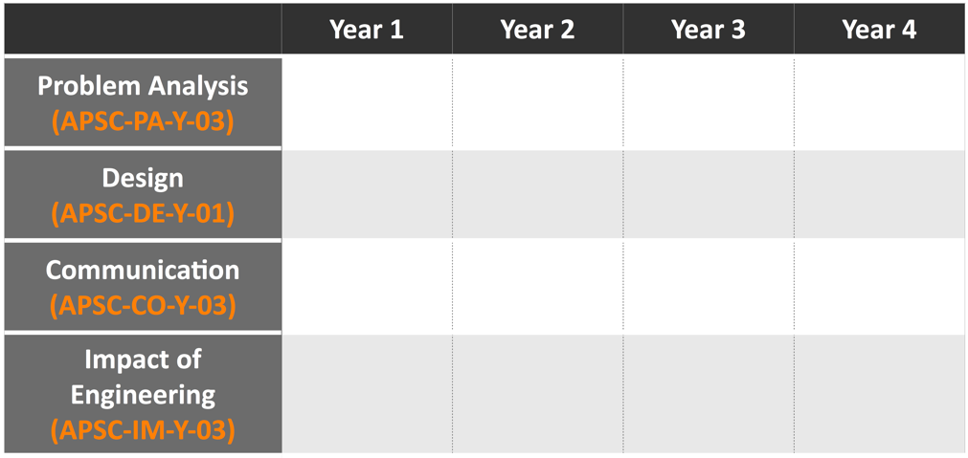
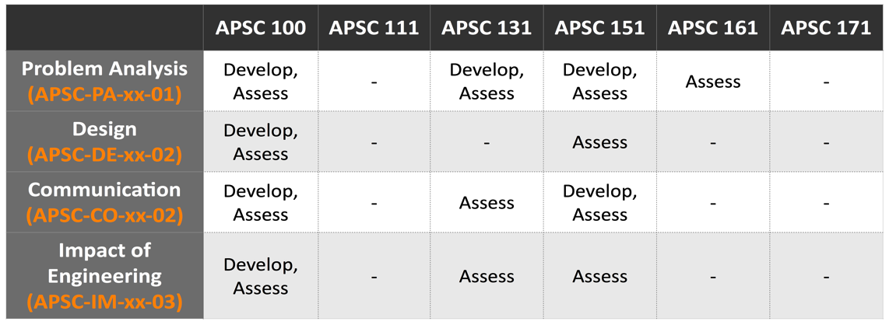
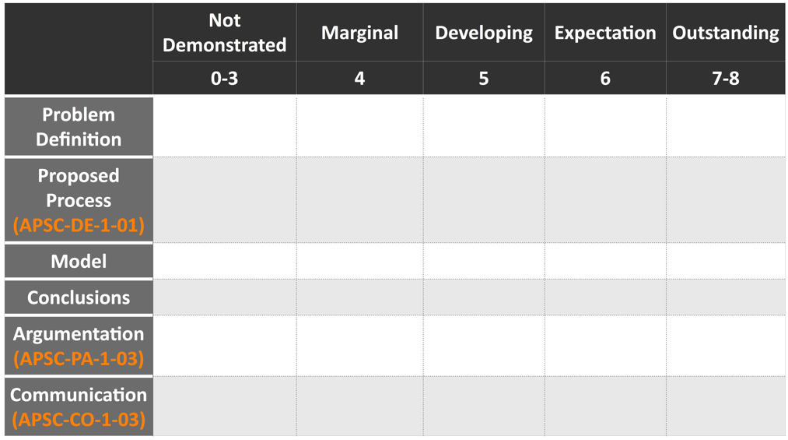
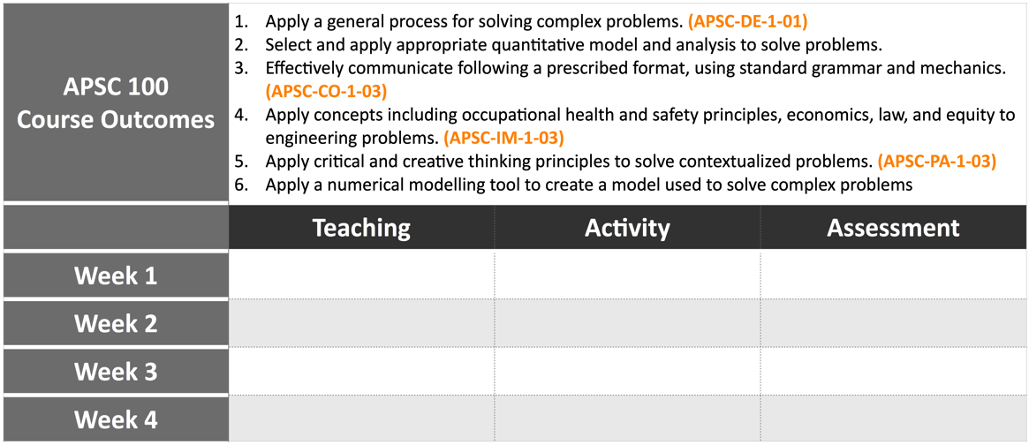
EGAD Recommended “Process tools”
Tool for Step 1: Indicator collection
Tool for Step 2: Curriculum map
Tool for Step 3: Course planning table
Tool for Step 3: Rubrics
Notes:
Engineers like structure and tools!

Slide 23
1
2
Program objectives and indicators
Mapping the curriculum
(Session 2)
What do you want to know about the program?
Curriculum & process improvement
Analyze and interpret
Planning & collecting data
5
4
3
STEP 1: Objectives and indicators
Notes:
General process informed by what do you want to know that is particular to your program – do you have a special stream you want to know more about? Do you have long-standing issues? Have you had concerns about a specific attribute?
In other established outcomes-based processes in engineering education, such as ABET’s EC2000 and (insert others), have intentionally left the universal outcomes vague, in order to encourage individual programs to distinguish themselves within their respective programs. Typically, programs created program specific objectives, and then developed the own learning outcomes from these objectives. In this case, the CEAB has termed these mid-level learning outcomes, indicators.
But what makes a GOOD indicator?
What do you want to know to improve your program? What innovative features do you want to study? What ongoing problems have you had?
These serve as guides as you create indicators, map your program, select people to be involved.

Slide 24
Indicators: examples
Lifelong learning
An ability to identify and address their own educational needs in a changing
world in ways sufficient to maintain their competence and to allow them to
contribute to the advancement of knowledge
Graduate
attribute
The student:
Critically evaluates information
for authority, currency, and
objectivity when referencing
literature.
Identifies gaps in knowledge and
develops a plan to address
Indicators
Describes opportunities for future
professional development.
Uses information ethically and legally
to accomplish a specific purpose
Notes:
I changed performance indicators to Indicators
BTW one of the critical indicators of a student’s ability to engage in Lifelong Learning is their ability to identify gaps in their knowledge and skill sets and create a plan to address them

Slide 25
Learning outcome (indicator) elements (from Biggs)
Level of expectation
(“describes”, “compares”, “applies”, “creates”, etc.)
Content area
Critically evaluates information for authority, currency, and
objectivity working independently on a research project.
context

Slide 26
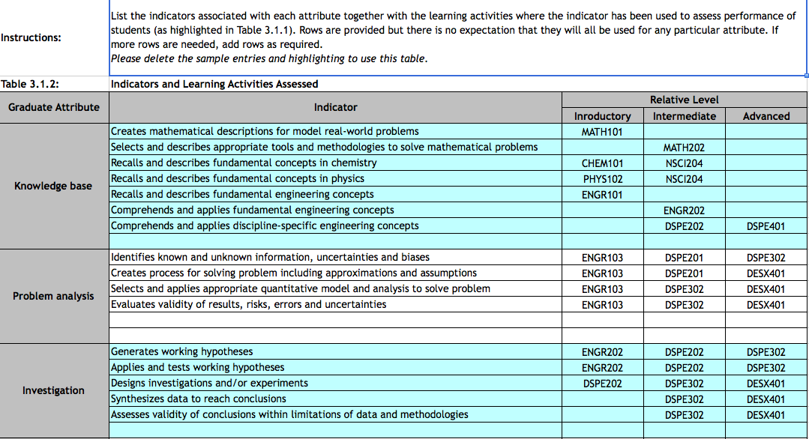
CEAB Reporting Requirements: Indicators

Slide 27
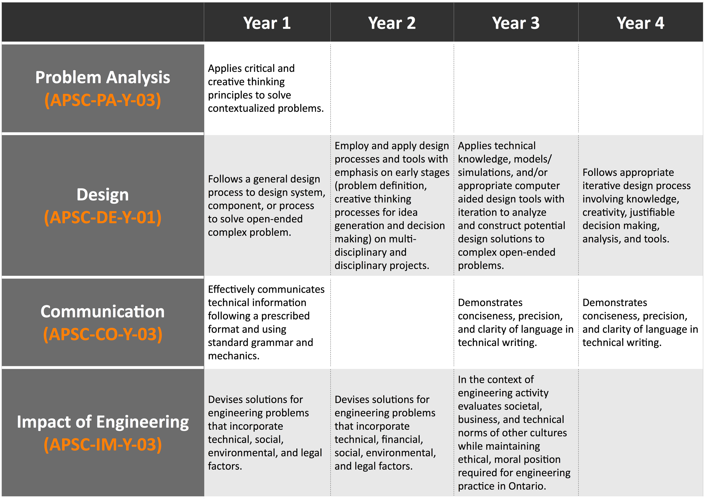
Process Tool: Indicator collection

Slide 28
1
2
Program objectives and indicators
Mapping the curriculum
(Session 3)
What do you want to know about the program?
Curriculum & process improvement
Analyze and interpret
Planning & collecting data
5
4
3
STEP 2: Mapping the curriculum
Notes:
General process informed by what do you want to know that is particular to your program – do you have a special stream you want to know more about? Do you have long-standing issues? Have you had concerns about a specific attribute?
In other established outcomes-based processes in engineering education, such as ABET’s EC2000 and (insert others), have intentionally left the universal outcomes vague, in order to encourage individual programs to distinguish themselves within their respective programs. Typically, programs created program specific objectives, and then developed the own learning outcomes from these objectives. In this case, the CEAB has termed these mid-level learning outcomes, indicators.
But what makes a GOOD indicator?
What do you want to know to improve your program? What innovative features do you want to study? What ongoing problems have you had?
These serve as guides as you create indicators, map your program, select people to be involved.

Slide 29
Curriculum Mapping
Where are attributes/
indicators developed?
Where are attributes/
indicators assessed?

Slide 30
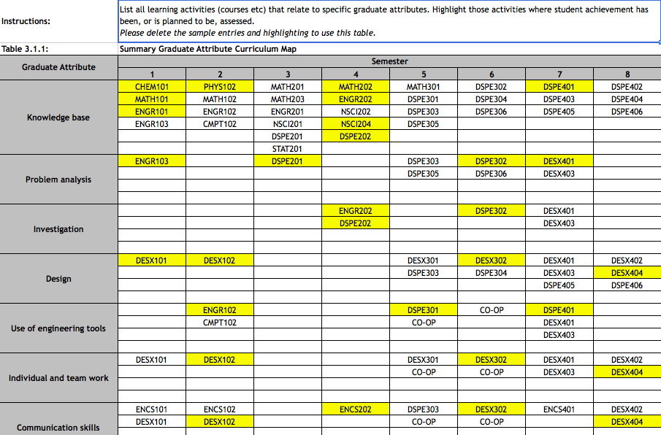
CEAB Reporting requirement

Slide 31
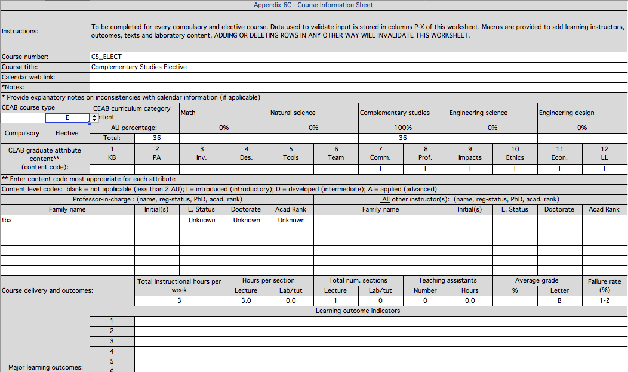
CEAB: Course learning outcomes

Slide 32

Process Tool: Curriculum map

Slide 33
Example: Mapping to Courses (UBC)
Introduce
Emphasize
Utilize
 |  | 1 | 2 | 3 | 4 | 5 | 6 | 7 | 8 | 9 | 10 | 11 | 12
Course | Number | Knowledge Base | Problem Analysis | Investigation | Design | Engineering Tools | Individual / Team Work | Communication | Professionalism | Impact of Engineering | Ethics / Equity | Econ. / Project Management | Life-long Learning
APSC | 150 | I | I |  | I | I | I |  | I | U | I |  | I
MATH | 100 | E | U | I |  |  |  | U |  | I |  |  | I
MATH | 101 | E | U | I |  |  |  | U |  | I |  |  | I
MATH | 152 | E | I | E |  | E |  |  |  |  |  |  | I
PHYS | 153 | E | E | E | I | I | E | U | U | U | U | I | U
PHYS | 170 | E | E | U | I | U | I | I
APSC | 201 | U | E | U | U | U | E | E | E |  | E | I | U
MATH | 253 | E | E | I | E |  | I | U |  | I | U |  | U
MATH | 256 | E | E | U | I | I
MECH | 220 | E | I | U | U | E | U | I | I | I | I |  | I
MECH | 221 | E | E | E | I | E | U | U | I | I | I |  | I
MECH | 222 | E | E | E | U | E | U | U | I | I | I | I | I
MECH | 223 | E | E | E | E | E | E | U | U | E | I | E | I

Slide 34
Useful pieces of information:
What methods of instruction do you use in your course? (What)
What methods of assessment are used in your course? (How)
Which program-level learning outcomes are developed in your course? (What)
What level of complexity/depth is expected for each of the learning outcomes? (Level)
Please specify how each of the learning outcomes are taught and assessed in your course. (How)

Slide 35
1
2
Program objectives and indicators
Mapping the curriculum
What do you want to know about the program?
(Session 3)
Curriculum & process improvement
Analyze and interpret
Planning & Collecting data
5
4
3
STEP 3: Collecting data
Notes:
General process informed by what do you want to know that is particular to your program – do you have a special stream you want to know more about? Do you have long-standing issues? Have you had concerns about a specific attribute?
In other established outcomes-based processes in engineering education, such as ABET’s EC2000 and (insert others), have intentionally left the universal outcomes vague, in order to encourage individual programs to distinguish themselves within their respective programs. Typically, programs created program specific objectives, and then developed the own learning outcomes from these objectives. In this case, the CEAB has termed these mid-level learning outcomes, indicators.
But what makes a GOOD indicator?
What do you want to know to improve your program? What innovative features do you want to study? What ongoing problems have you had?
These serve as guides as you create indicators, map your program, select people to be involved.

Slide 36
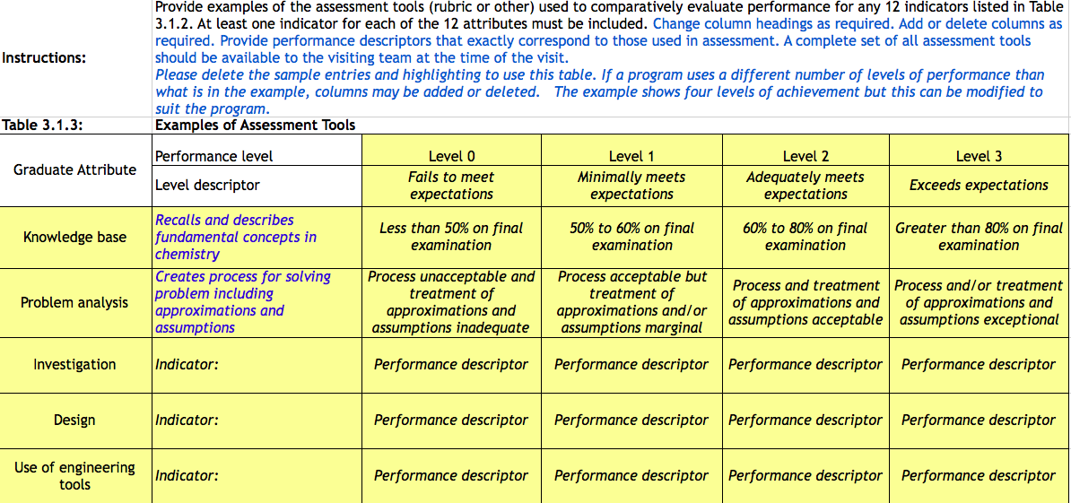
CEAB Reporting Requirement – Assessment tools

Slide 37
Assessment Tools
How to measure learning against specific expectations?
Direct measures – directly observable or measurable assessments of student learning
E.g. Student exams, reports, oral examinations, portfolios, concept inventories etc.
Indirect measures – opinion or self-reports of student learning or educational experiences
E.g. grades, surveys, focus group data, graduation rates, reputation, etc.

Slide 38
Programmatic assessment approaches
Direct
Indirect
Context:
Courses
Program
Inter-institutional
Student
ePortfolios
Direction by:
Embedded
in-course
Instructor
Program tests
Meta rubrics
(e.g. VALUE)
Standardized tests
(FE Exam, CLA+)
Program
Local surveys/
focus groups
National surveys
(e.g. NSSE)

Slide 39
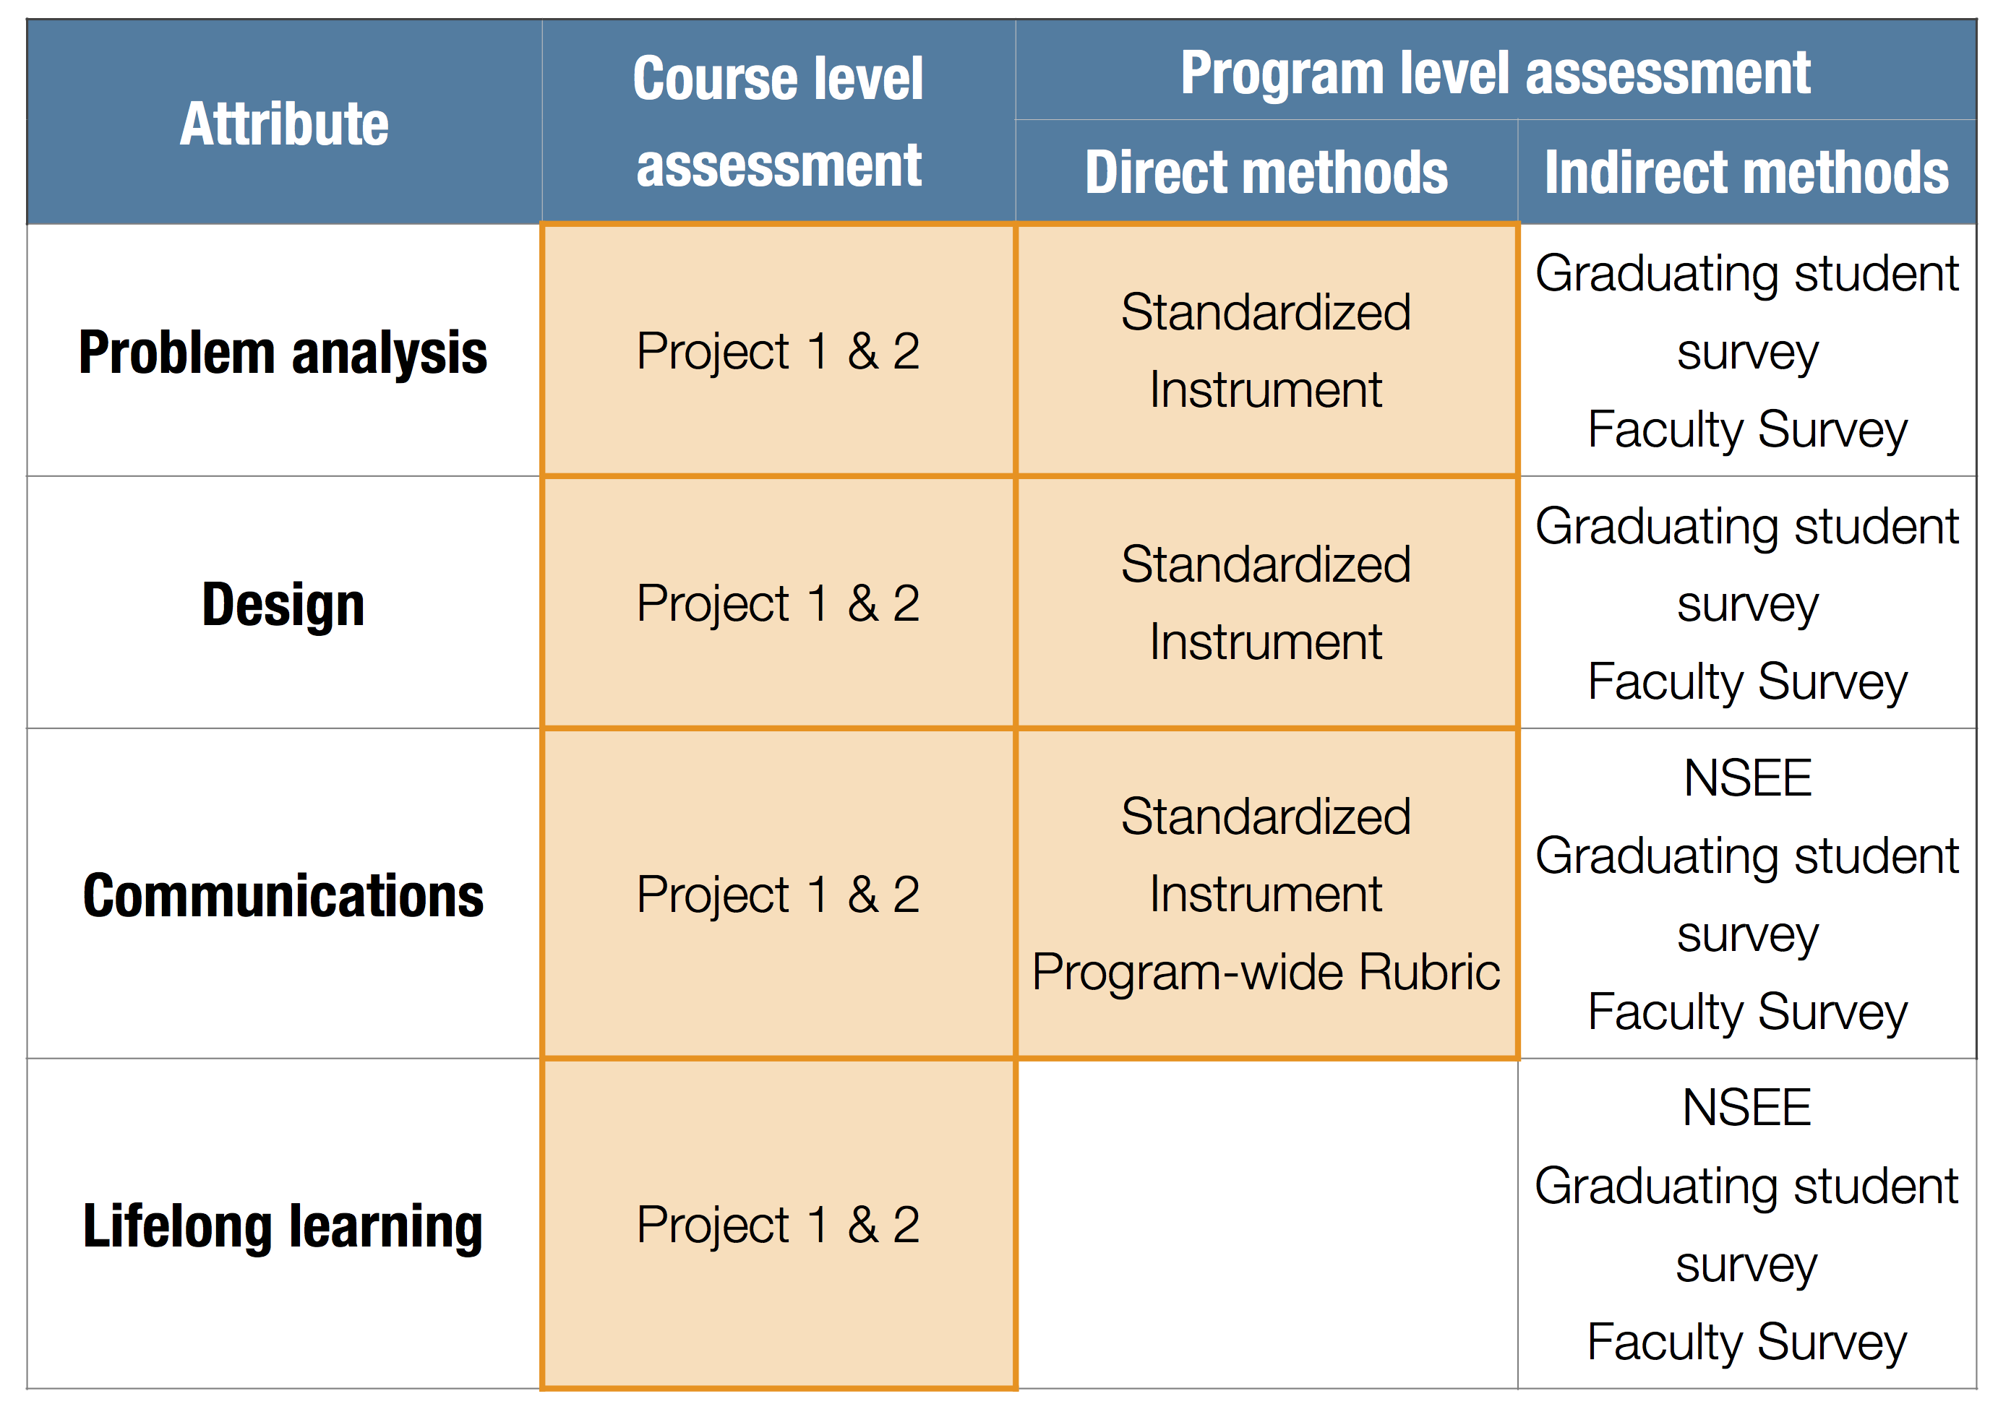
Process tool: Assessment plan

Slide 40
Queen’s delegation plan
Knowledge
Problem anal
Eng tools
Design
Communications
…
Individual program
What are key expectations of your program?
Mostly focus on knowledge, engineering tools, and problem analysis
Multi-department. E.g.:
Service teaching (e.g. math)
Engineering science program taking MECH, ECE courses
Mostly focus on knowledge and engineering tools
Faculty-wide
First year and faculty-wide courses
Mostly focus on first year knowledge, design, and on professional skills
Program wide surveys including NSSE, meta-rubric assessment, CLA+

Slide 41
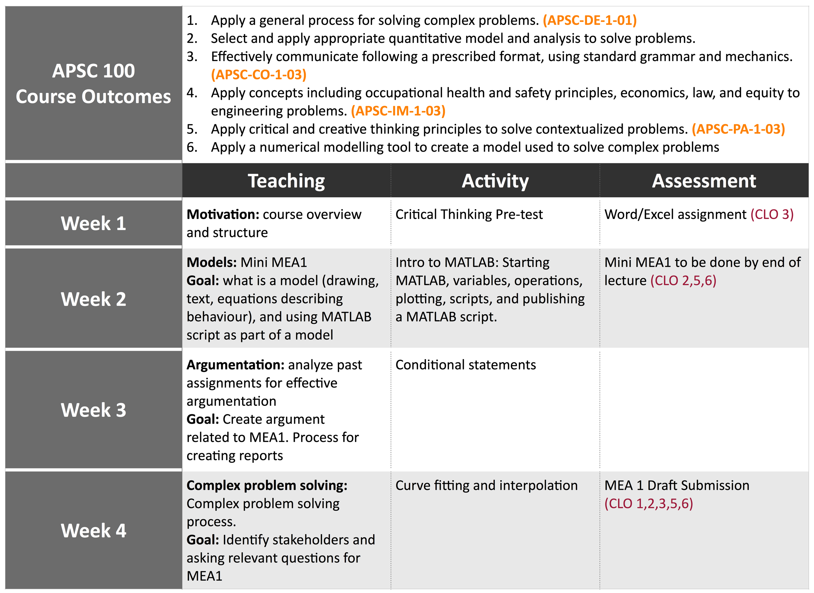
Process Tool: Course planning table

Slide 42
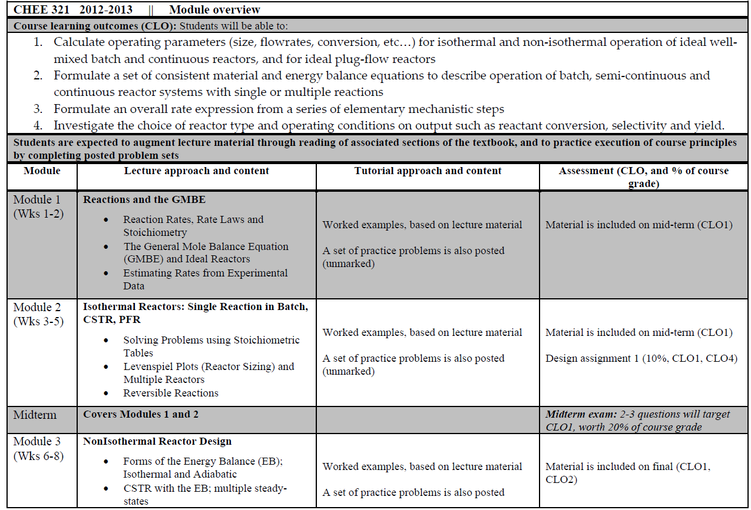
(Session 3 Activity)

Slide 43
Assessment methods
Local written exam
(e.g. question on final)
External examiner
(e.g. Reviewer on design projects)
Standardized written exam
(e.g. Force concept inventory)
Oral exam
(e.g. Design projects presentation)
Performance appraisal
(e.g. Lab skill assessment)
Oral interviews
Simulation
(e.g. Emergency simulation)
Surveys and questionnaires
Behavioural observation
(e.g. Team functioning)
Focus group
Portfolios
(student maintained material)
Archival records
(registrar's data, records, ...)

Slide 44
Scoring
Numeric (mark out of 10)
Rubric (discrete levels with description of performance)
Complete/not complete

Slide 45
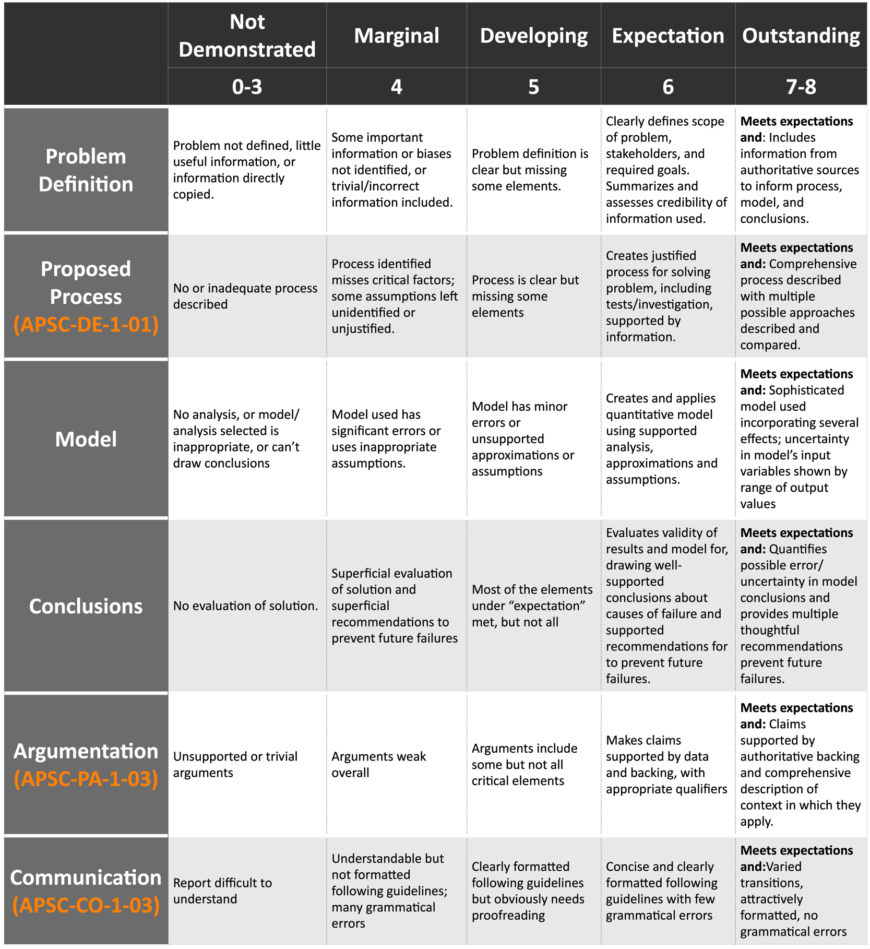
Process Tool:
Rubric

Slide 46
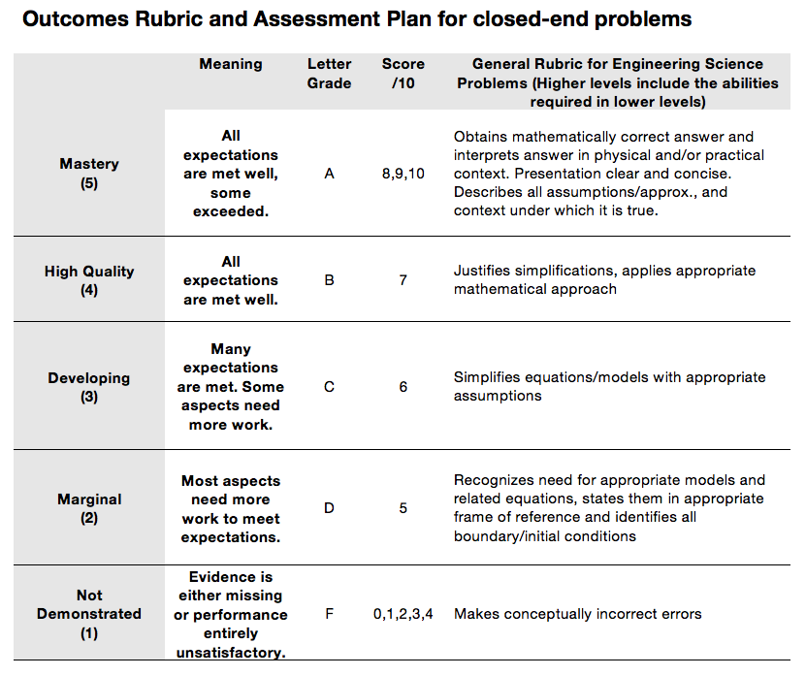

Slide 47
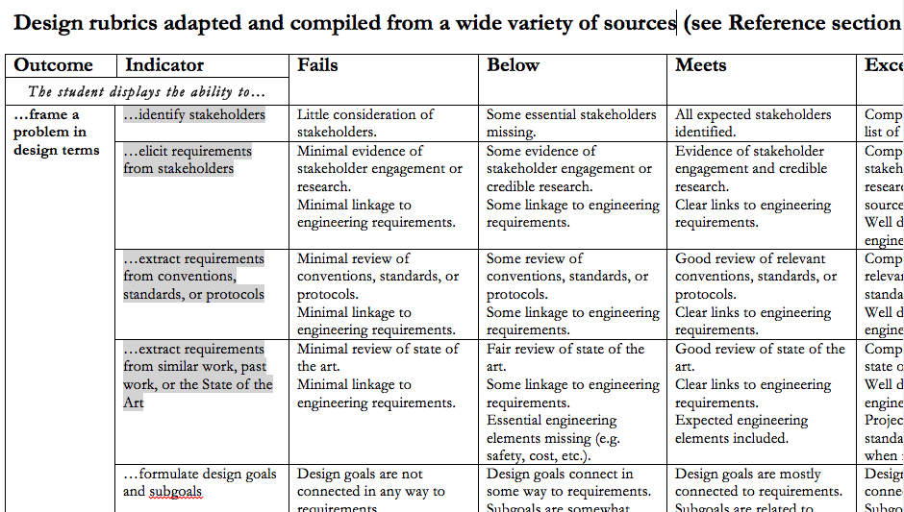
Validated rubric development (University of Toronto)

Slide 48
Example: Rubric for design report (UBC)

Slide 49
Example: Assessing math knowledge (Queen’s)
Calculus course had three learning outcomes that were indicators for Knowledge base in first year:
Create mathematical descriptions or expressions to model a real-world problem
Select and describe appropriate tools to solve mathematical problems that arise from modeling a real-world problem
Use solution to mathematical problems to inform the real-world problem that gave rise to it
Instructor assessed those by specific questions on exam
Notes:
49

Slide 50
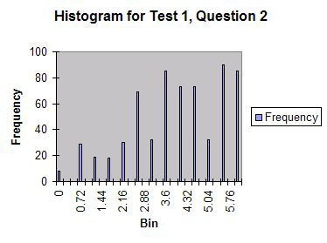
Example (cont’d):
Outcome #1: Create mathematical descriptions or expressions to model a real-world problem
Question Context: calculating intersection of two trajectories

Slide 51
Tracking outcomes scores derived from exams
Student name | Exam mark (/100) | Learning outcome 1 mark from exam question 2 (/6) | Learning outcome 2 mark from exam question 5 (/6)
Bill | 70 | 6 | 2
Sandra | 72 | 4 | 6
Ahmed | 86 | 6 | 6
Yin | 68 | 3 | 4

Slide 52
1
2
Program objectives and indicators
Mapping the curriculum
What do you want to know about the program?
(Session 4)
Curriculum & process improvement
Analyze and interpret
Collecting data
5
4
3
STEP 4: Analyze and interpret
Notes:
General process informed by what do you want to know that is particular to your program – do you have a special stream you want to know more about? Do you have long-standing issues? Have you had concerns about a specific attribute?
In other established outcomes-based processes in engineering education, such as ABET’s EC2000 and (insert others), have intentionally left the universal outcomes vague, in order to encourage individual programs to distinguish themselves within their respective programs. Typically, programs created program specific objectives, and then developed the own learning outcomes from these objectives. In this case, the CEAB has termed these mid-level learning outcomes, indicators.
But what makes a GOOD indicator?
What do you want to know to improve your program? What innovative features do you want to study? What ongoing problems have you had?
These serve as guides as you create indicators, map your program, select people to be involved.

Slide 53
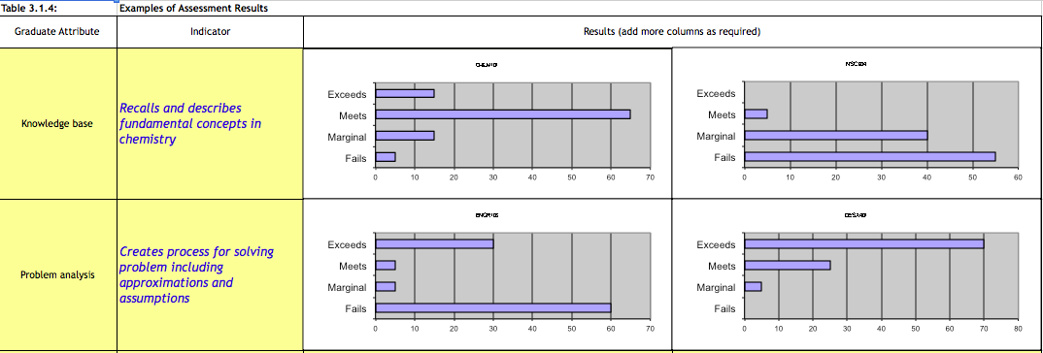
CEAB reporting requirement

Slide 54
Approaches to Analyzing data
Look at data by indicator/attribute
Aggregate indicators and plot
Cross sectional comparison (e.g. 1st vs 4th year)
Longitudinal
Compare between institutions
Compare special programs within institutions

Slide 55
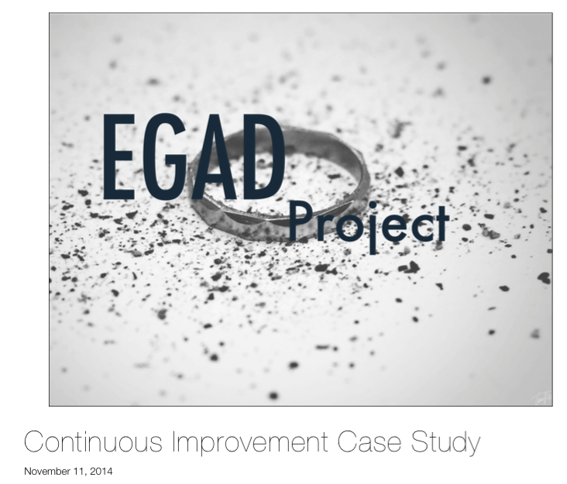
(Session 4 activity)

Slide 56
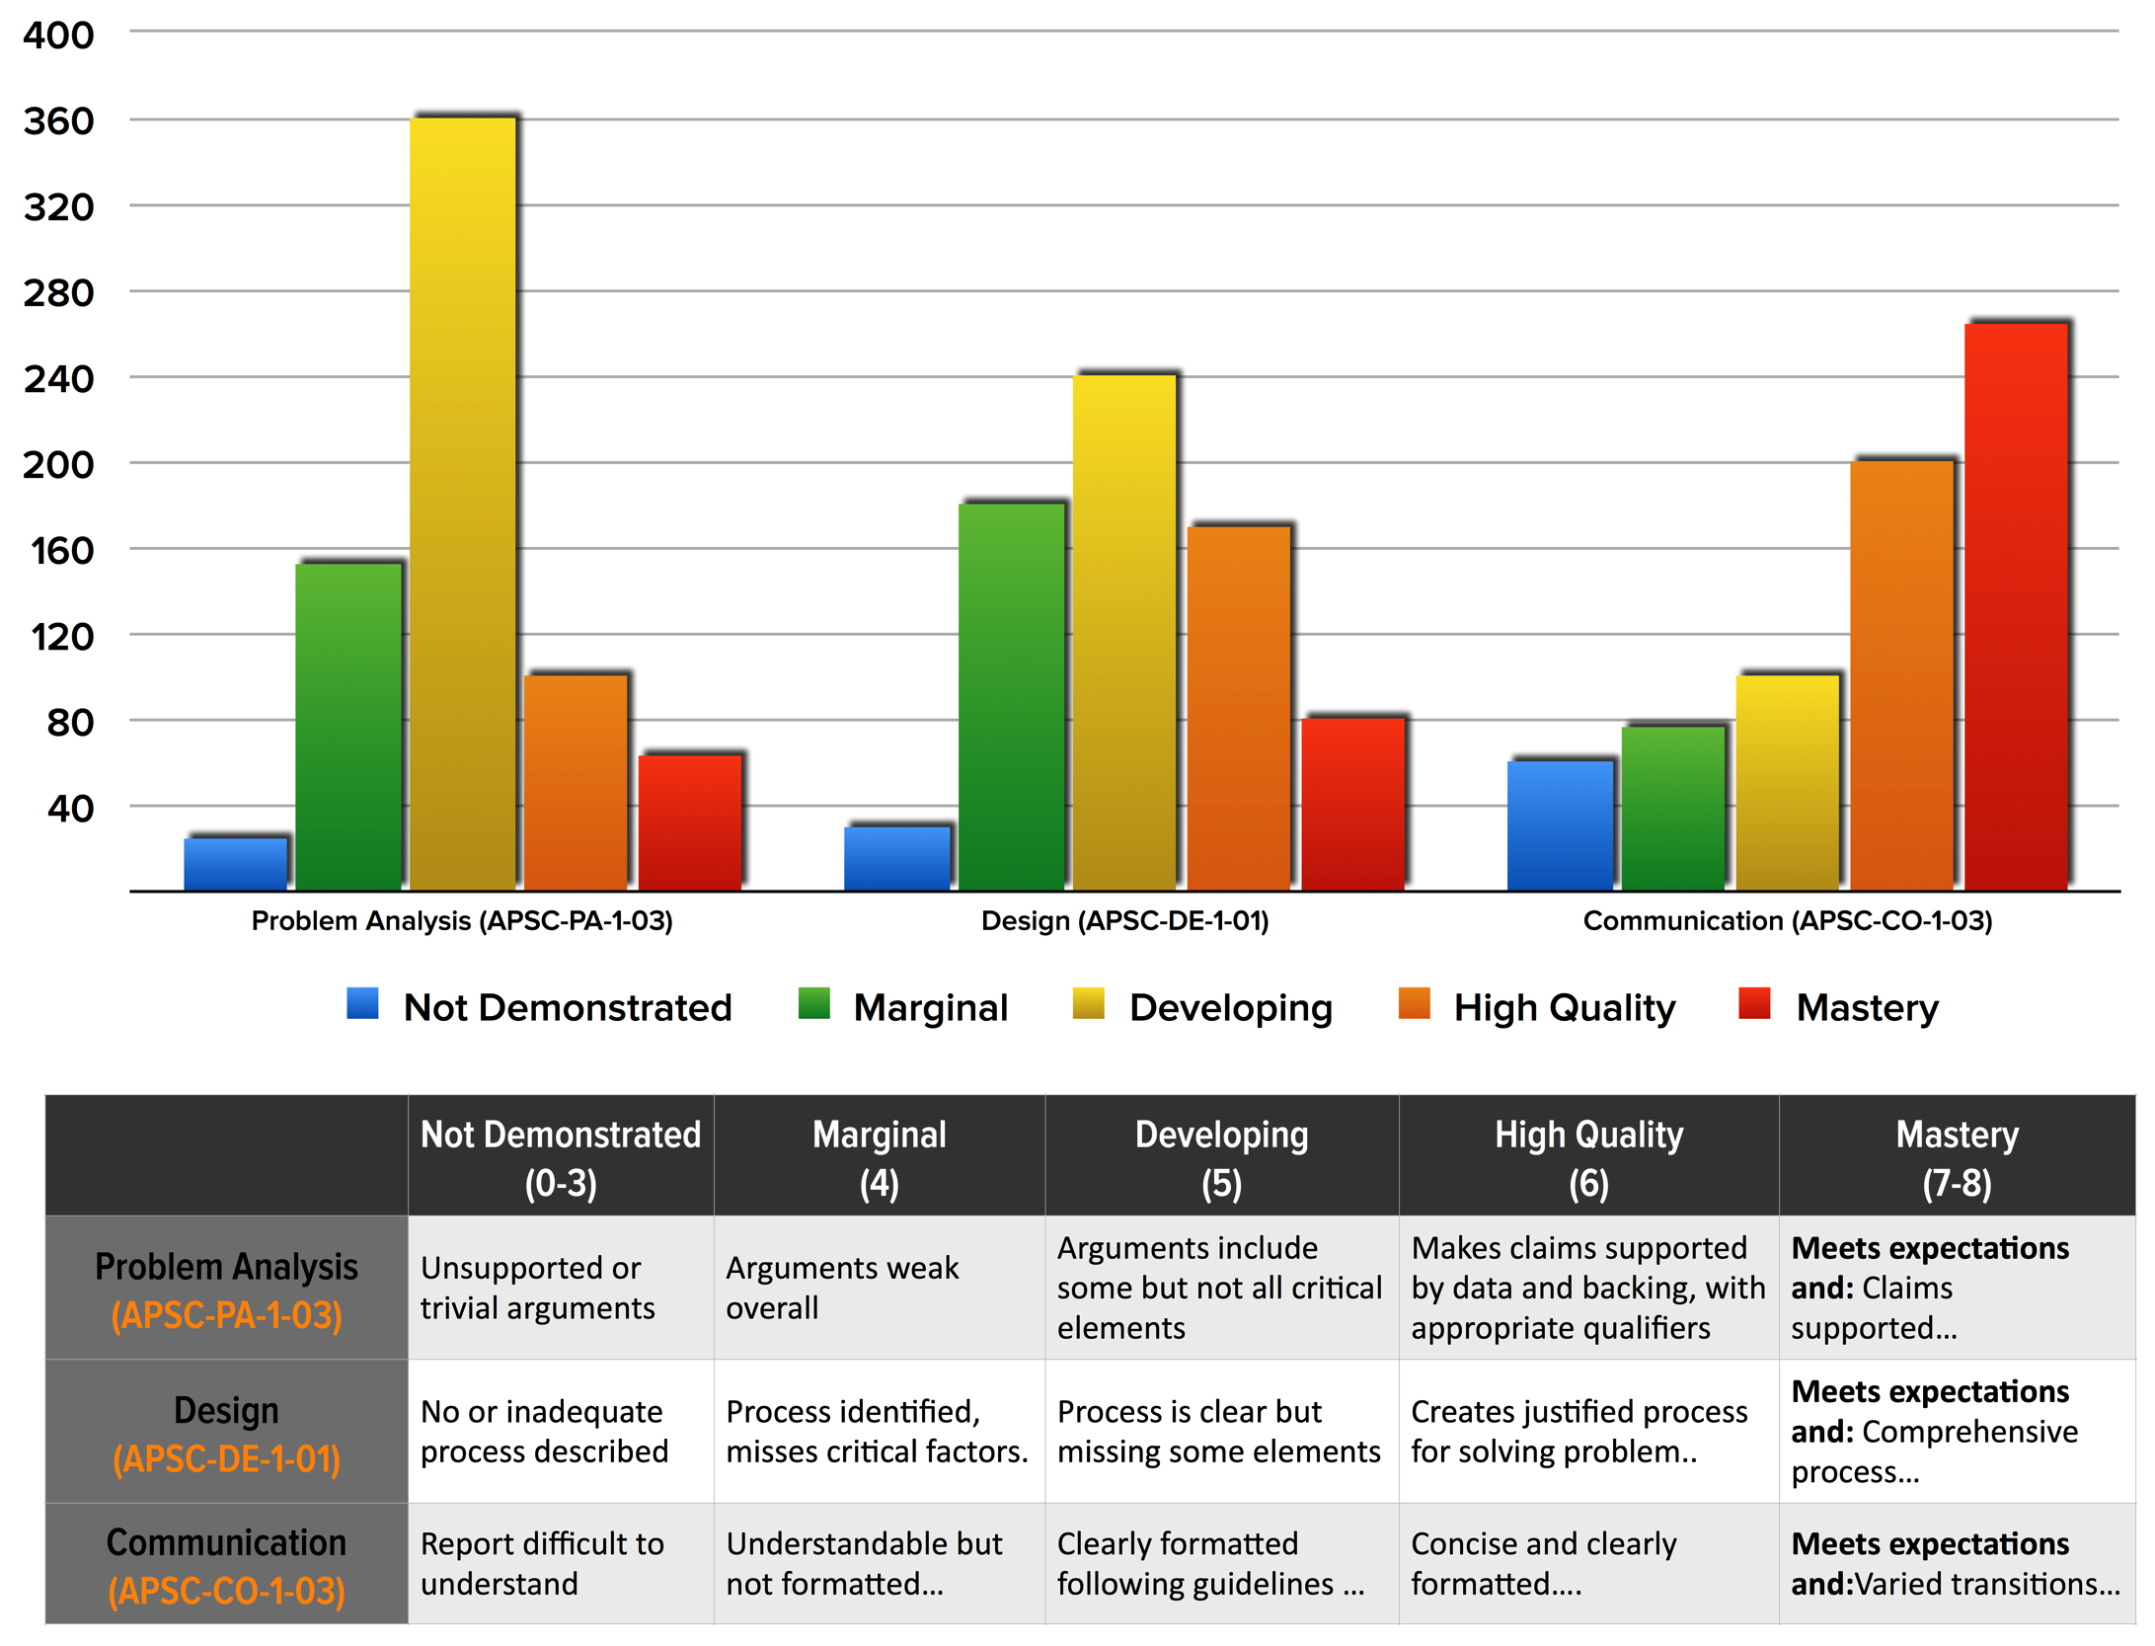

Slide 57
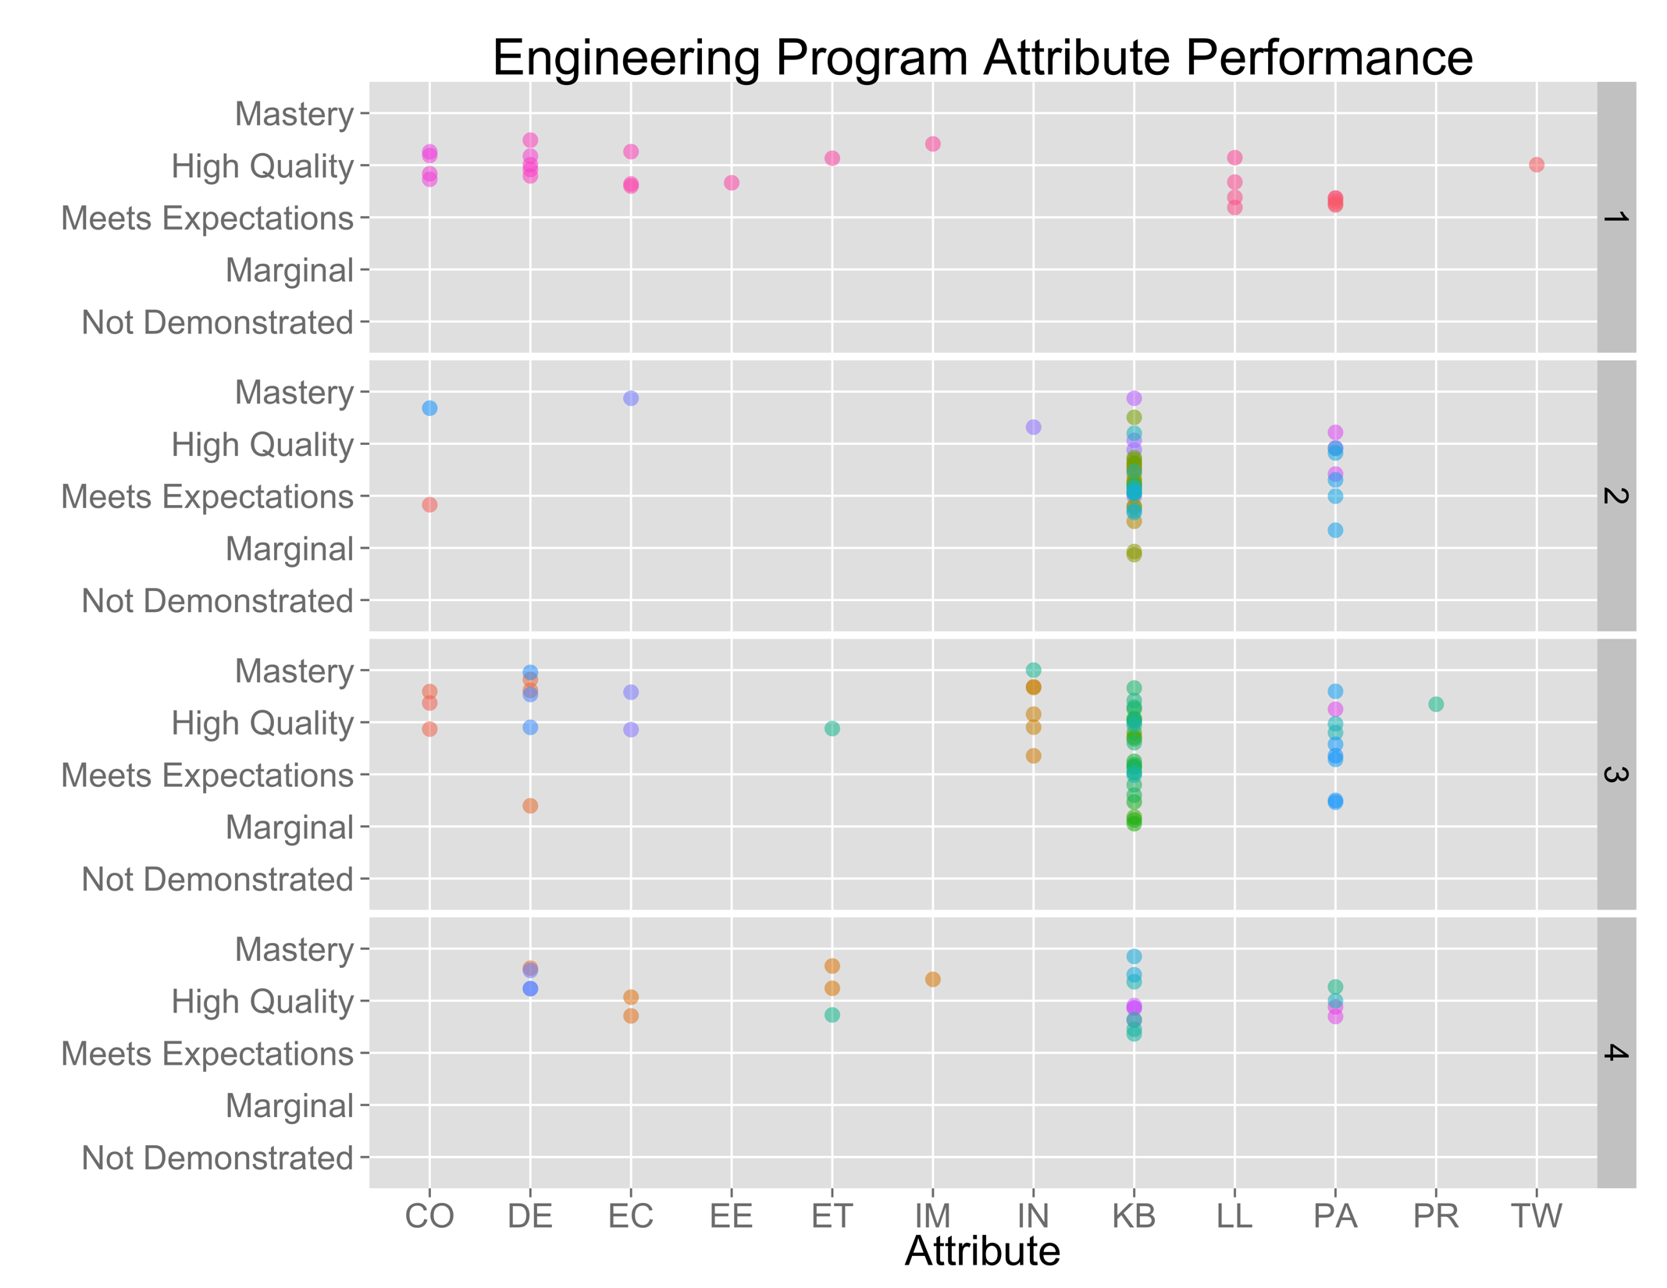
Priority 1: Resources
First year
Aggregating
Second year
Third year
Fourth year
Notes:
Open source software, R Project.

Slide 58
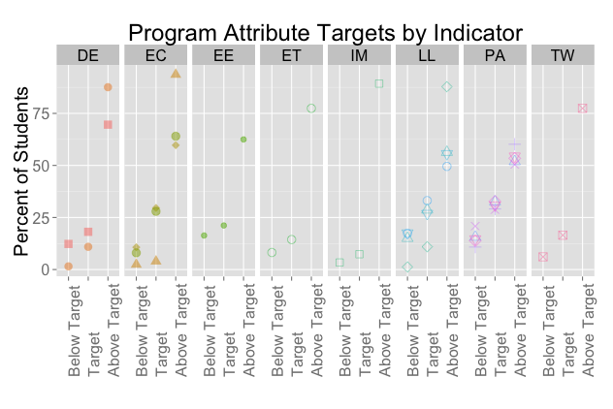
Priority 1: Resources
By indicator

Slide 59
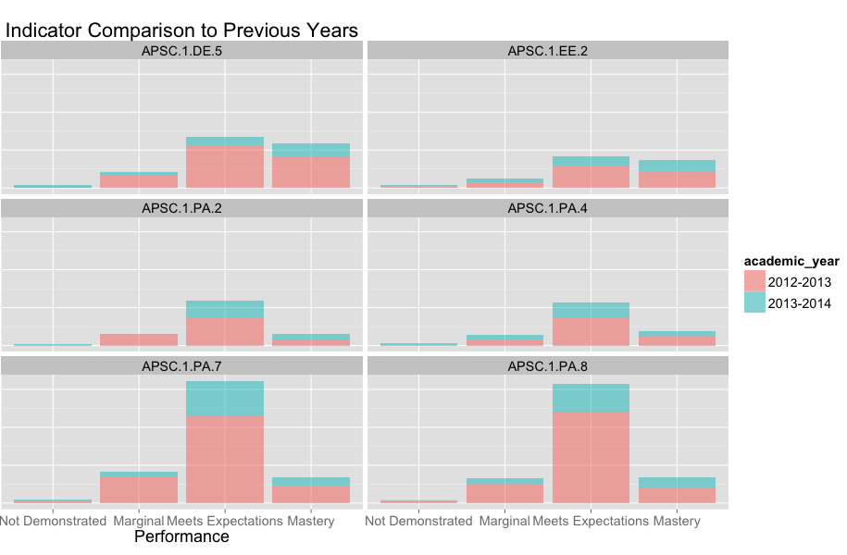
Multiple years

Slide 60
Program-wide rubrics

Slide 61
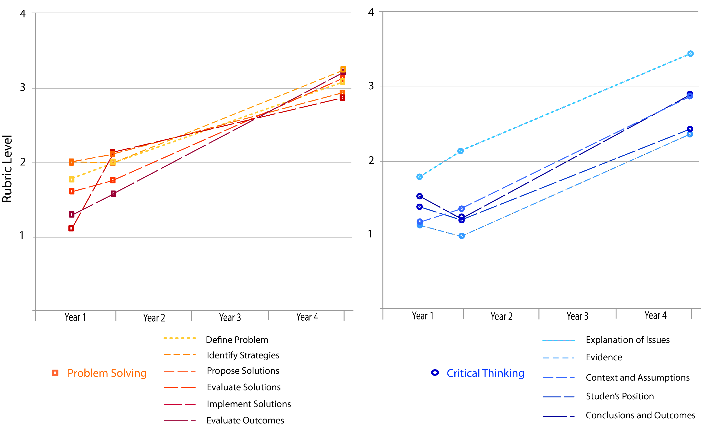
Student development

Slide 62
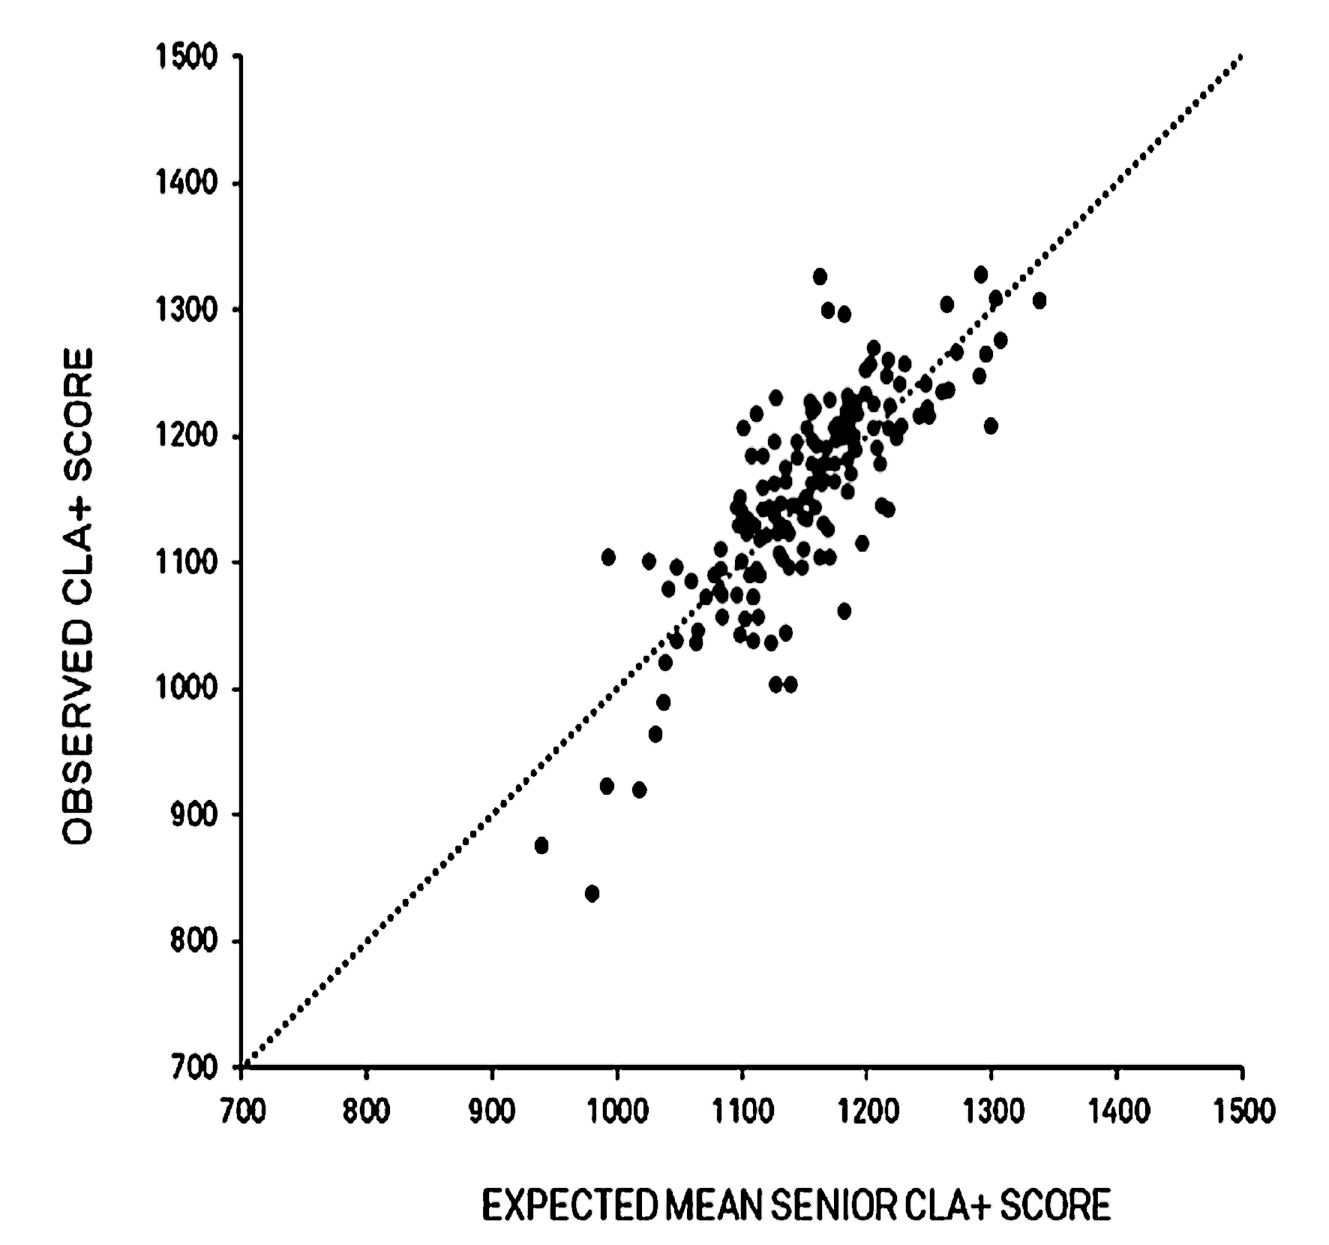
Benchmarking
1st Year- 90th Percentile
4th Year- 98th Percentile
Exiting 4th Year means from all participating 4-Year Colleges and Universities
Queen’s University 1st Year (μ=1169) n=546
Queen’s University 4th Year (μ=1258) n=41

Slide 63
1
2
Program objectives and indicators
Mapping the curriculum
What do you want to know about the program?
Curriculum & process improvement
Analyze and interpret
Collecting data
5
4
3
STEP 5: Curriculum and process improvement
Notes:
General process informed by what do you want to know that is particular to your program – do you have a special stream you want to know more about? Do you have long-standing issues? Have you had concerns about a specific attribute?
In other established outcomes-based processes in engineering education, such as ABET’s EC2000 and (insert others), have intentionally left the universal outcomes vague, in order to encourage individual programs to distinguish themselves within their respective programs. Typically, programs created program specific objectives, and then developed the own learning outcomes from these objectives. In this case, the CEAB has termed these mid-level learning outcomes, indicators.
But what makes a GOOD indicator?
What do you want to know to improve your program? What innovative features do you want to study? What ongoing problems have you had?
These serve as guides as you create indicators, map your program, select people to be involved.

Slide 64
Program decisions and changes
CEAB is looking for linkage between the outcomes assessment process and official curriculum oversight (curriculum committee, etc.)
Critical to have decision making group involved in the outcomes assessment process

Slide 65
Curriculum changes informed by data
Queen’s: In 2011, our data led us to make some changes:
Need to communicate the process better to students; describe learning objectives in courses.
First year: focus on improving how to make effective arguments, evaluating complex problem solutions against objectives, written communications, and evaluating information
Second year: emphasis on summarizing important information clearly and concisely, effectively participating in informal small group discussions, and on risk assessment and project planning

Slide 66
Software tools to support outcomes assessment

Slide 67






Previous tools review:

Slide 68
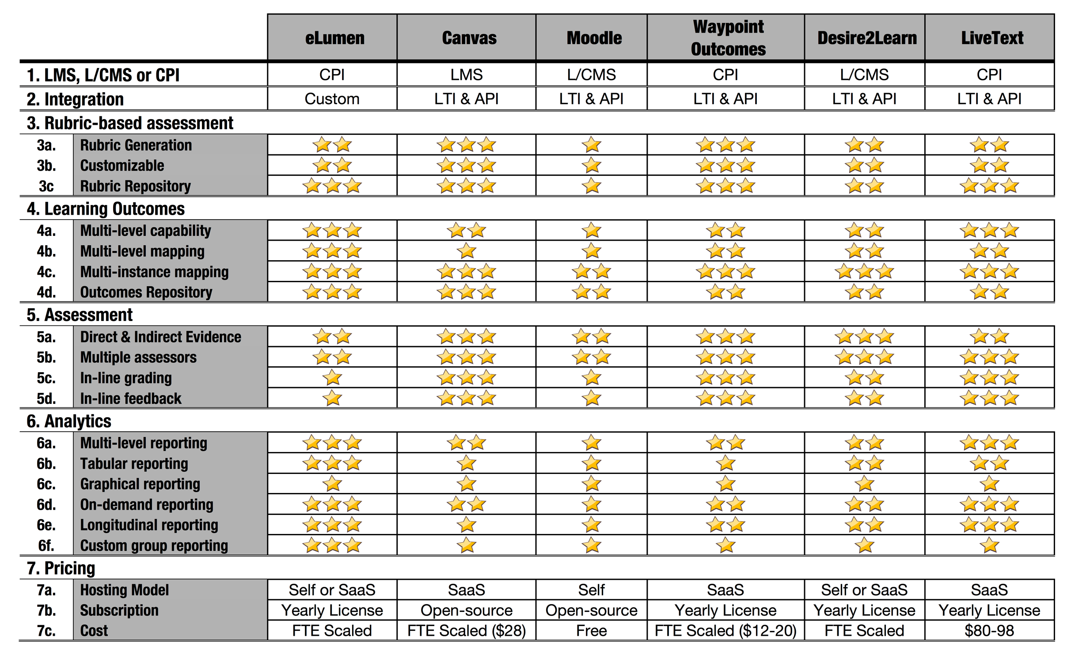

Slide 69






Slide 70
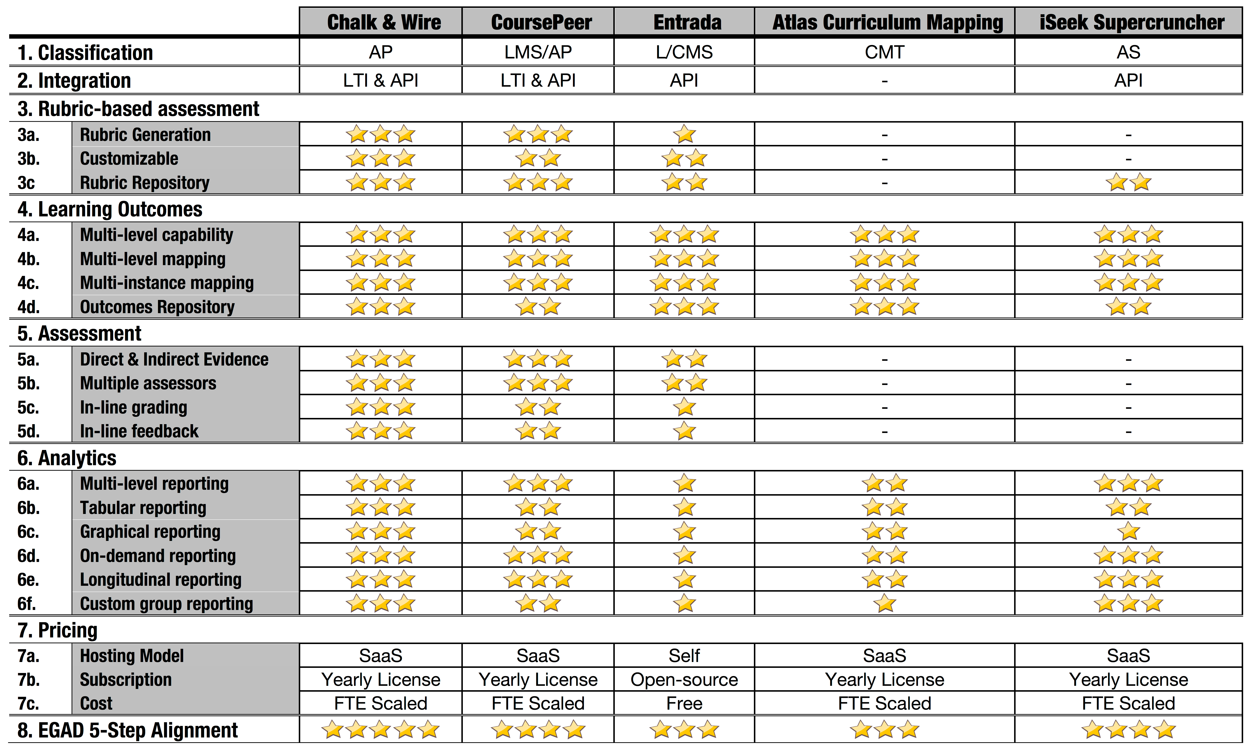

Slide 71






This year at the Canadian Engineering Education Association conference:

Slide 72
Other activity in Canada
UBC: Indirect qualitative assessment of GA’s using student surveys as well.
UBC: assessing outcomes using design dossiers
Memorial: Using a formative approach to assessing GA’s throughout course experiences using course-based outcomes & assessments. Also using ePortfolios for assessment and to facilitate student reflection.
Toronto: using communications portfolios for assessment of LLL, Communication & professionalism
Calgary: using exit and alumni surveys for indirect assessment
Ryerson: assessing LLL using work of students in national design competitions

Slide 73
End of the Big Picture

Slide 74
Session 2: Goals, Questions, and OUTCOMES

Slide 75
Goals of session 2
As a department, identify program goals
Identify questions that program hopes to answer answer by the outcomes assessment process
Identify the status of current indicators and plan future work in developing

Slide 76
Your turn: What do you hope to get from the process?

Slide 77
Your turn: What do you want to know?
In groups, share some information you would like to know about your program to improve the quality of graduating students
E.g. do you have anecdotal concerns about:
Ability to write
Ability to work in a team
Ability to use hardware/software
Ability to apply engineering science knowledge on realistic problems
Ability to …
Or would you like to compare performance of different groups of students?

Slide 78
Learning outcomes (Biggs)
Level of expectation
(“describes”, “compares”, “applies”, “creates”, etc.)
Content area
Critically evaluates information for authority, currency, and
objectivity
when prompted (disposition)
after instruction (proximity)
in unfamiliar topics (familiarity)
applying disciplinary declarative knowledge
within a time limit…
context

Slide 79
Learning outcomes (Allan, 1994)
Subject-based outcomes
Personal transferable outcomes, e.g.
Teamwork
Numeracy
Organizational skills
Generic academic outcomes, e.g.
Critical thinking
Analyze

Slide 80
Attribute domains
Declarative
(“knowing that”)
Procedural
(“knowing how”)
Schematic
(“knowing why”)
Strategic
(“knowing when and how it applies”)
Generic transferable
(teaming, critical thinking, communication)
(Shavelson, 2003; Allan, 1994)

Slide 81
Your turn: As a program, create a plan for developing/enhancing indicators
If no current indicators:
Who needs to be involved in creating them?
Process for creating indicators – subdivide into small working groups?
Process for providing feedback on course learning outcomes?
If indicators exist:
Is there consensus among the department about the indicators?
Are there gaps?
Quality of indicators – are they measurable & meaningful?

Slide 82
Session 3: Curriculum mapping and assessment

Slide 83
Curriculum Mapping
Where are attributes/
indicators developed?
Where are attributes/
indicators assessed?

Slide 84
CEAB Reporting requirement

Slide 85
CEAB: Course learning outcomes

Slide 86
Process Tool: Curriculum map

Slide 87
Questions for mapping
What are your course learning outcomes? (What)
Does your course specifically develop the CLO? (How)
Which Program level learning outcomes (indicators/GA's) map to your CLOs (What)
What are your assessments? (How)
When do these occur? (When)
Which CLOs map to which assessment? (Where)
What is the type of each assessment? (What)
What is the complexity of the assessment? (Complexity)
What scaffolding is provided in the assessment? (Scaffolding)
How long between instruction and assessment of CLO? (How)
Who assesses student work? (Who)
What are the expectations for achieving the outcome? (Expectations)

Slide 88
Visualizing the curriculum

Slide 89
Visualizing the curriculum
Problem analysis
Area=# learning outcomes
Colour=# assessments

Slide 90
Visualizing the curriculum
Ethics and equity
Area=# learning outcomes
Colour=# assessments

Slide 91
Your turn: As a program, create a plan for developing/enhancing curriculum map
If no current curriculum map:
Who needs to be involved in creating it?
Process for creating curriculum map – representatives from key areas in department?
If map exists:
Is there consensus among the department about the map?
Are there gaps in the map?
Where are indicators assessed?

Slide 92
Assessment planning

Slide 93
Why not use grades to assess outcomes?
How well does the program prepare
students to solve open-ended
problems?
Student transcript
Electric Circuits I Electromagnetics I Signals and Systems I Electronics I Electrical Engineering Laboratory Engineering Communications Engineering Economics ... Electrical Design Capstone | 78 56 82 71 86 76 88 86
Are students prepared to continue
learning independently after
graduation?
Do students consider the social
and environmental implications of
their work?
Course grades usually aggregate
assessment of multiple objectives,
and are indirect evidence for
some expectations
What can students do with
Knowledge? Can they communicate
effectively?

Slide 94
Norm referenced evaluation
Criterion referenced evaluation
Student: You are here!
(67%)
“Student has marginally met expectations because submitted work mentions social, environmental, and legal factors in design process but no clear evidence of that these factors
impacted on decision making.”
Grades
Used for large scale evaluation to compare
students against each other
Used to evaluate students against stated
criteria. Useful for feedback to student
and conversation within a program

Slide 96
CEAB Reporting Requirement – Assessment tools

Slide 97
Programmatic assessment approaches
Direct
Indirect
Context:
Courses
Program
Inter-institutional
Student
ePortfolios
Direction by:
Embedded
in-course
Instructor
Program tests
Meta rubrics
(e.g. VALUE)
Standardized tests
(FE Exam, CLA+)
Program
Local surveys/
focus groups
National surveys
(e.g. NSSE)

Slide 98
Process tool: Assessment plan

Slide 99
TASK: Data audit DURATION: 20 MINUTES
In a team, select identify data that already exists, or is already being collected, that provide direct or indirect evidence of competence:
Surveys/focus groups
Research studies in engineering or broadly at university
Data already being collected in courses
Internship/exchange
Admissions data
Graduating student surveys, alumni surveys
Graduate completion rates
…

Slide 101
Assessment Tools
How to measure learning against specific expectations?
Direct measures – directly observable or measurable assessments of student learning
E.g. Student exams, reports, oral examinations, portfolios, concept inventories etc.
Indirect measures – opinion or self-reports of student learning or educational experiences
E.g. grades, surveys, focus group data, graduation rates, reputation, etc.

Slide 102
What to look for in assessment tools
Workload: Results in a feasible workload for students and graders
Generalizability: Results are representative of entire program/class
Content: The assessment tool is clearly aligned with the outcome
Reliability: Results will be consistent between graders, or if tested again
Actionable: Provides useful information related to educational experience that can be used for course and/or program improvement

Slide 103
Selecting Assessments
Looking for assessments that are:
Valid: they measure what they are supposed to measure
Reliable: the results are consistent; the measurements are the same when repeated with the same subjects under the same conditions
Capitalize on what you are already doing
Look for “leading Indicators”
One approach for dealing with qualitative assessments (not the only!) is with Rubrics

Slide 104
Examples of assessment tools
Local written exam
(e.g. question on final)
External examiner
(e.g. Reviewer on design projects)
Standardized written exam
(e.g. Force concept inventory)
Oral exam
(e.g. Design projects presentation)
Performance appraisal
(e.g. Lab skill assessment)
Oral interviews
Simulation
(e.g. Emergency simulation)
Surveys and questionnaires
Behavioural observation
(e.g. Team functioning)
Focus group
Portfolios
(student maintained material)
Archival records
(registrar's data, records, ...)

Slide 105
TASK: Selecting assessment in a course DURATION: 20 MINUTES
In a team, select assessment tools appropriate to the course learning outcomes, considering:
Workload: Results in a feasible workload for students and graders
Generalizability: Results are representative of entire program/class
Content: The assessment tool is clearly aligned with the outcome
Reliability: Results will be consistent between graders, or if tested again
Actionable: Provides useful information related to educational experience that can be used for course and/or program improvement

Slide 106
Discussion
Formative/summative assessment
Linkage between outcomes and topics
Workload
Generalizability
Content alignment
Reliability
Actionability

Slide 107
Example: First year design course

Slide 108
First year design
course project
rubric

Slide 109
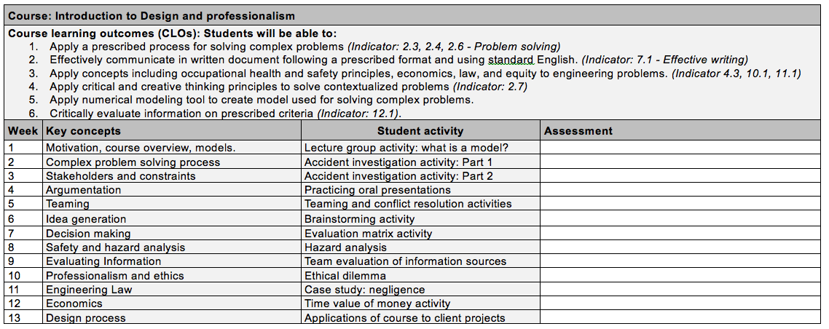
Part 1: Group 1 – Design course assessment

Slide 110
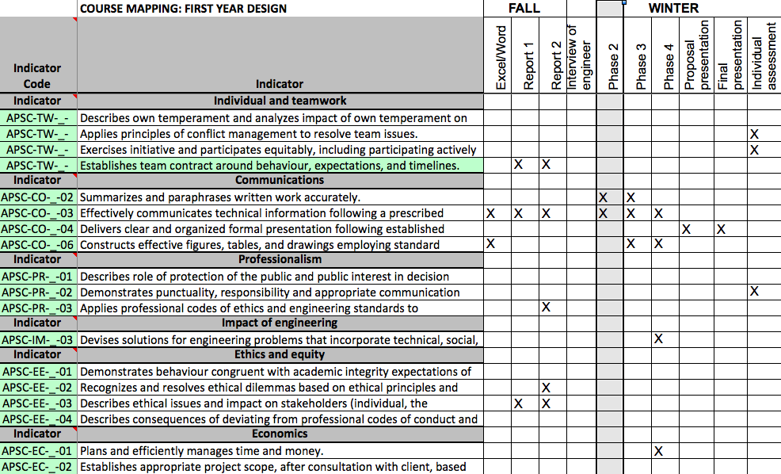

Slide 111
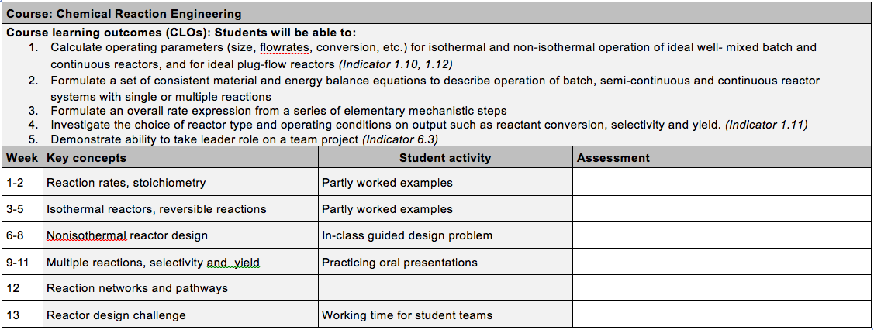
Part 1: Group 2 – Chemical Engineering

Slide 112
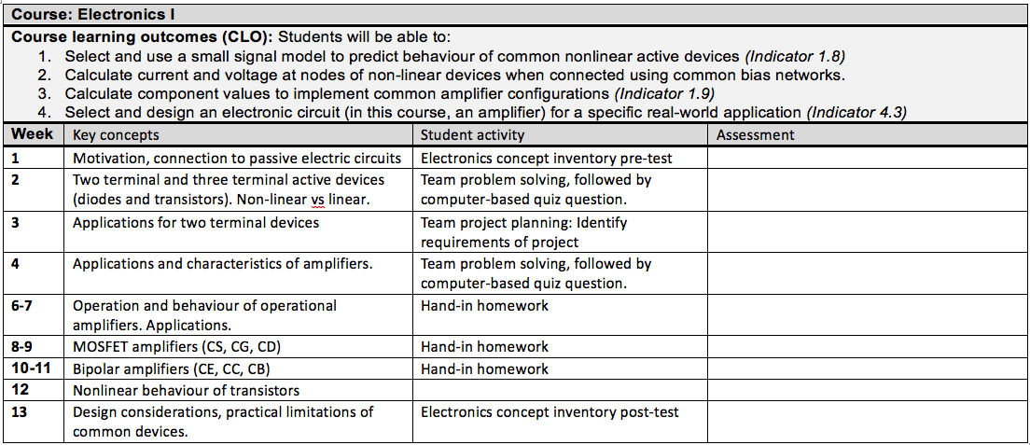
Part 1: Group 3 – Electrical Engineering

Slide 113
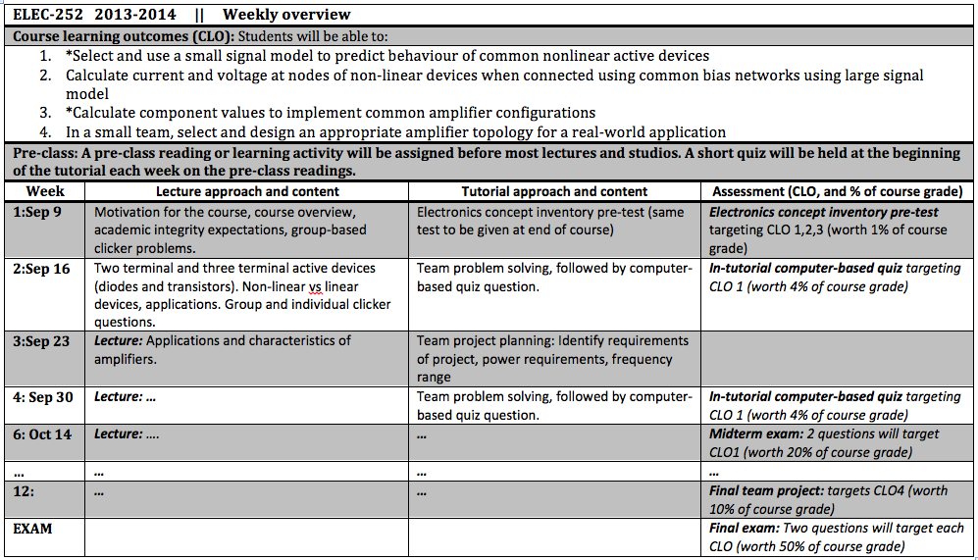

Slide 114
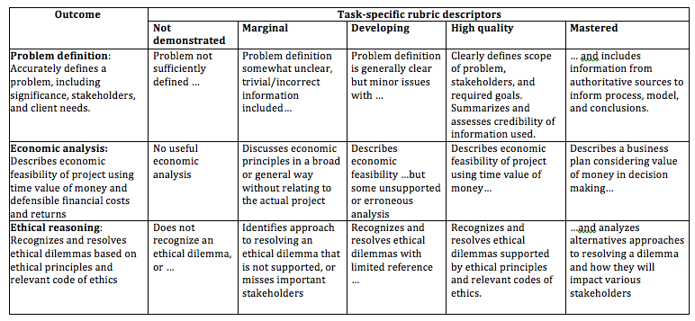
First year design course data

Slide 115
Session 4: Analyzing and interpreting data

Slide 116
Approaches to Analyzing data
Look at data by indicator/attribute
Aggregate indicators and plot
Cross sectional comparison (e.g. 1st vs 4th year)
Longitudinal
Compare between institutions
Compare special programs within institutions

Slide 117
CEAB reporting requirement

Slide 118
Student development

Slide 119
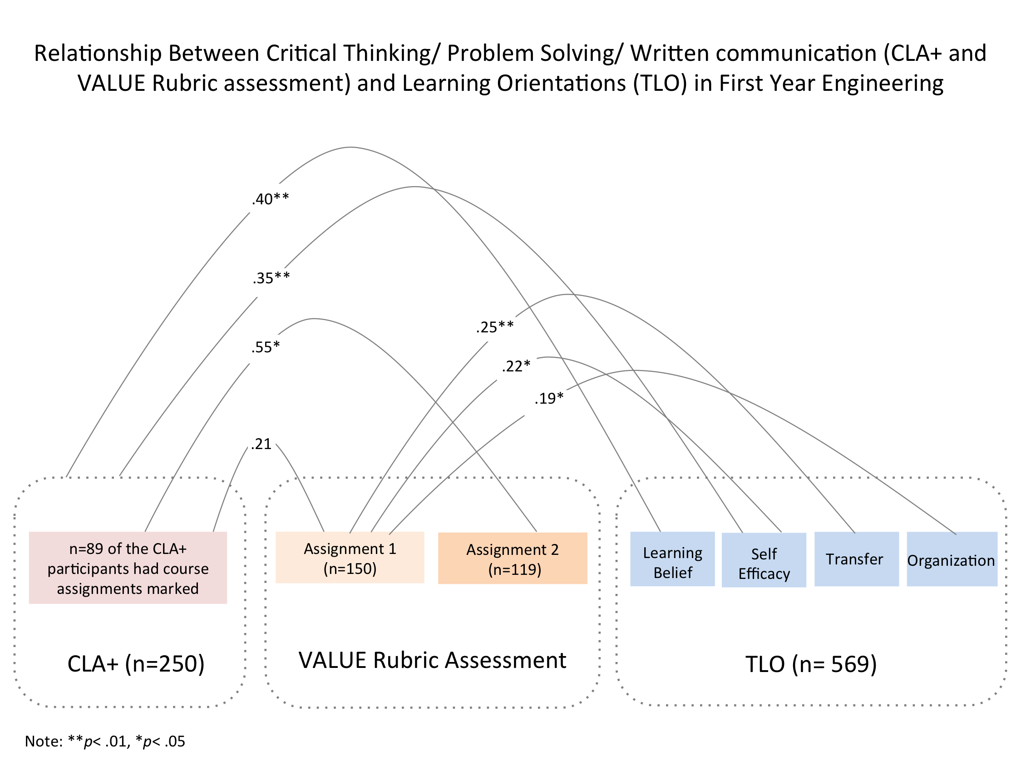

Can we trust our data? Triangulation

Slide 120
Benchmarking
1st Year- 90th Percentile
4th Year- 98th Percentile
Exiting 4th Year means from all participating 4-Year Colleges and Universities
Queen’s University 1st Year (μ=1169) n=546
Queen’s University 4th Year (μ=1258) n=41

Slide 121
Priority 1: Resources
First year
Year
Second year
Third year
Fourth year
Notes:
Open source software, R Project.

Slide 122
Priority 1: Resources
First year
Year
Second year
Third year
Fourth year
Notes:
Open source software, R Project.

Slide 123
Priority 1: Resources
First year
Year
Second year
Third year
Fourth year
Notes:
Open source software, R Project.

Slide 124
Priority 1: Resources
First year
Year
Second year
Third year
Fourth year
Notes:
Open source software, R Project.

Slide 126

Triangulation: Can we trust the data?
Standardized
Measurement
Collegiate Learning Assessment (CLA+)
Critical Thinking Assessment Test (CAT)
Transferable Learning Orientations Survey (TLO)
Qualitative
Performance
Evaluation
Course Embedded Measures
Team observations to see the students’ intellectual skill development
Valid Assessment of Learning in Undergraduate Education (VALUE) rubrics for evaluation of course work

Slide 127
Data sources
In-course assessment (exams, reports, etc.)
Program wide assessment (e.g. common rubrics)
Standardized tests (concept inventory, etc.)
Surveys: NSSE, exit surveys, alumni surveys
Advisory board
Retention/failure/withdrawal rates
Research studies
Employers
Co-op/internship reports

Slide 128
Data sources
In-course assessment (exams, reports, etc.)
Program wide assessment (e.g. common rubrics)
Standardized tests (concept inventory, etc.)
Surveys: NSSE, exit surveys, alumni surveys
Advisory board
Retention/failure/withdrawal rates
Research studies
Employers
Co-op/internship reports

Slide 129
Case study context
All programs in an engineering faculty Drill down to first year design course
Attributes | Problem analysis Communication Design Lifelong learning
Assessment | In-class assessment in first year design course Data from other courses Standardized test of critical thinking and writing of first and fourth year students Program-wide rubrics used to score first and fourth year design reports

Slide 130
Assessment in the study

Slide 131
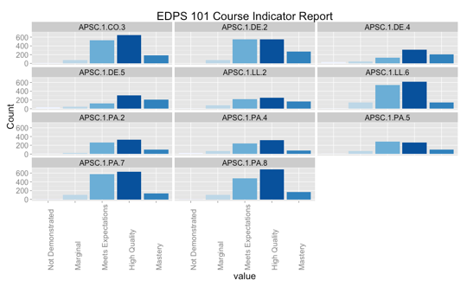
1. Course data

Slide 132
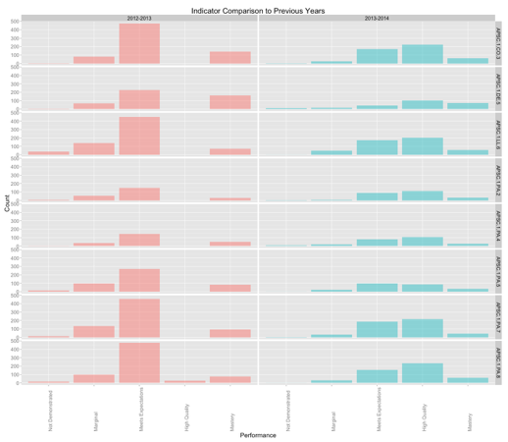
1. Course data over time

Slide 133
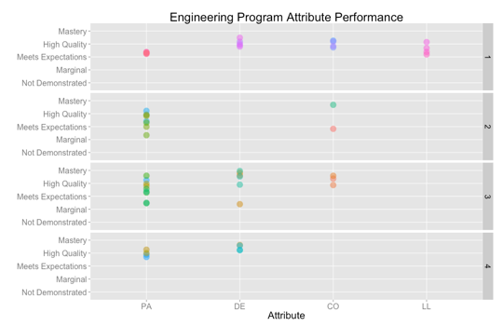
2. Data from 1st-4th yr courses

Slide 134
3. Standardized test of critical thinking and
Communication (Collegiate Learning Assessment)
First year
Fourth year

Slide 135
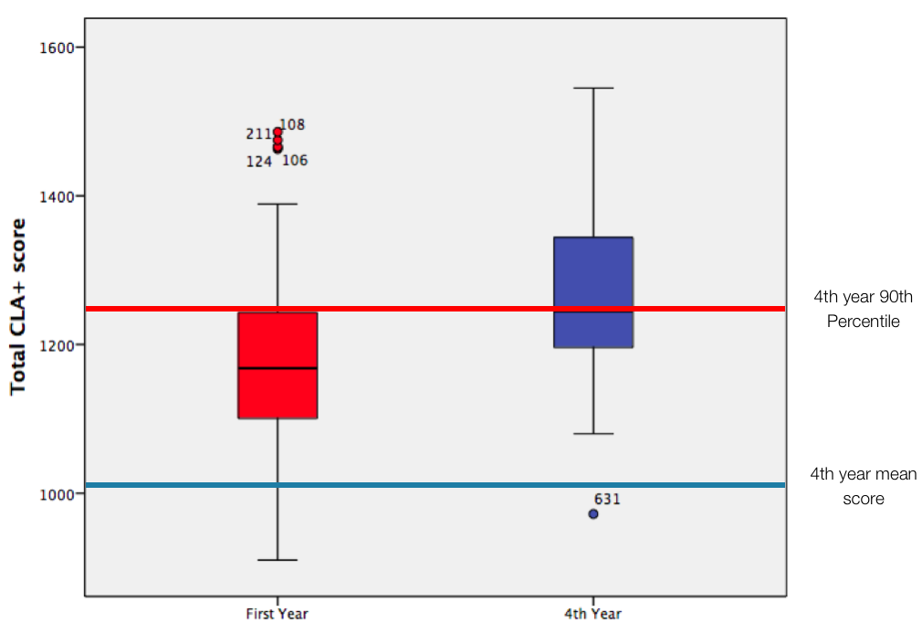
3. Standardized test results vs. other universities

Slide 136
4. Design reports scored using program-wide rubrics
Problem analysis
Communication

Slide 137
TASK: Case study DURATION: 30 MINUTES
Your team is the curriculum committee tasked with reviewing data from your program. Currently focusing on problem analysis (PA), design (DE), communications (CO), lifelong learning (LL).
Assess quality and quantity of data
Make recommendation to the course/program, and process.
Notes:
Video is at:
https://www.youtube.com/watch?v=M66ZU2PCIcM
Start at around 0:40.
Key elements:
Divide into small teams, gathering information and generating multiple ideas
Importance of talking to experts early – identify what is really important. Find client needs.
“Designate people to make sure store owner’s perspective is represented.”
Mantra for design - “One conversation at a time” Stay focused. Encourage wild ideas. Defer judgement. Build on the ideas of others.
Brainstorming. Vote with post-it.
Enlighted trial and error succeeds over the ideas of an enlightened genius.
Autocratic process to set time contraints, process.
Combine multiple innovative ideas.
Fail often to succeed sooner

Slide 138
TASK: Case study DURATION: 30 MINUTES
Phase 1: Review context (pages 3-6)
Phase 2: Break up the data between team members, for example:
first year course assessment (pages 7-8)
overall course-based program assessment (page 9)
standardized instrument (pages 10-11)
program-wide rubrics (page 12)
Phase 3: Address questions
Is there enough data, and do you trust it?
What improvements would you recommend to the course/program, and process?
Notes:
Video is at:
https://www.youtube.com/watch?v=M66ZU2PCIcM
Start at around 0:40.
Key elements:
Divide into small teams, gathering information and generating multiple ideas
Importance of talking to experts early – identify what is really important. Find client needs.
“Designate people to make sure store owner’s perspective is represented.”
Mantra for design - “One conversation at a time” Stay focused. Encourage wild ideas. Defer judgement. Build on the ideas of others.
Brainstorming. Vote with post-it.
Enlighted trial and error succeeds over the ideas of an enlightened genius.
Autocratic process to set time contraints, process.
Combine multiple innovative ideas.
Fail often to succeed sooner

Slide 139
PA=Problem analysis
DE=Design
CO=Communication
LL=Lifelong learning

Slide 140
TASK: Debrief case study DURATION: 10 MINUTES
Is there enough data, and do you trust it?
What improvements would you recommend to the course/program, and process?
Notes:
Video is at:
https://www.youtube.com/watch?v=M66ZU2PCIcM
Start at around 0:40.
Key elements:
Divide into small teams, gathering information and generating multiple ideas
Importance of talking to experts early – identify what is really important. Find client needs.
“Designate people to make sure store owner’s perspective is represented.”
Mantra for design - “One conversation at a time” Stay focused. Encourage wild ideas. Defer judgement. Build on the ideas of others.
Brainstorming. Vote with post-it.
Enlighted trial and error succeeds over the ideas of an enlightened genius.
Autocratic process to set time contraints, process.
Combine multiple innovative ideas.
Fail often to succeed sooner

Slide 141

Using assessment data for program improvement
http://bit.ly/EGADCU

Slide 142
Order of attributes, common format
Definitions – what do acronyms mean
What are expectations
Interpreting too many plots, different formats
What are targets in the plot
CEAB – targets/thresholds
Team vs indiidual – context
Exam vs report, rubric – all the context in the same place as the plot
Std deviation, p values between

Slide 143
Areas for improvement
Problem analysis, specifically effective argumentation and self-evaluation. First year students are at least on par with students other programs in those areas, and considerably better than many other institutions. However, it is still an area of relative weakness.
Communications: Communication skill development was weak in early iterations of the program first year. The program was overhauled, including greater clarity about written communication format, more frequent and rich feedback, and direct instruction. Syntax and mechanics better than sources and evidence. This is an area for development in future years.

Slide 144
Session 5: Process and planning

Slide 145
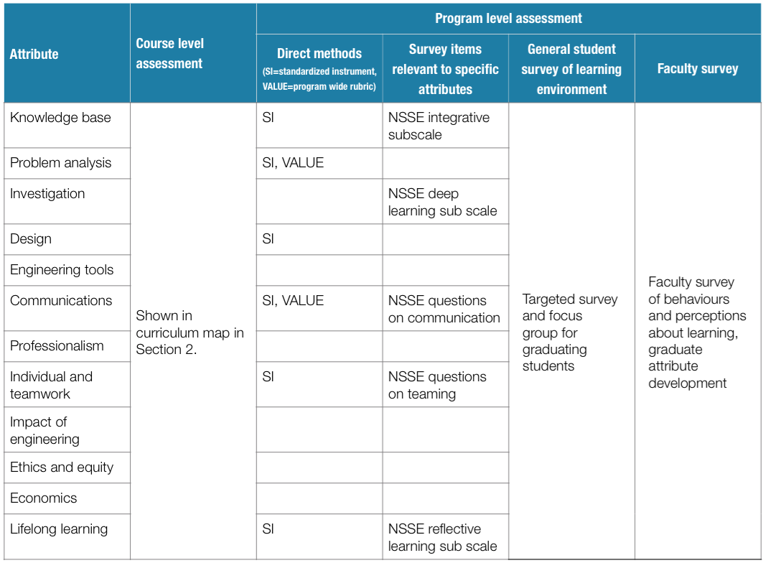

Slide 146
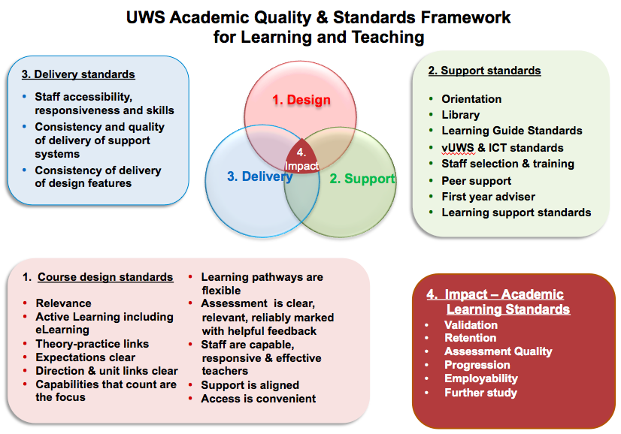
Goal: Use data to improve X
http://www.uws.edu.au/__data/assets/pdf_file/0004/182686/Diagrams_2.3_and_3.2.pdf

Slide 147
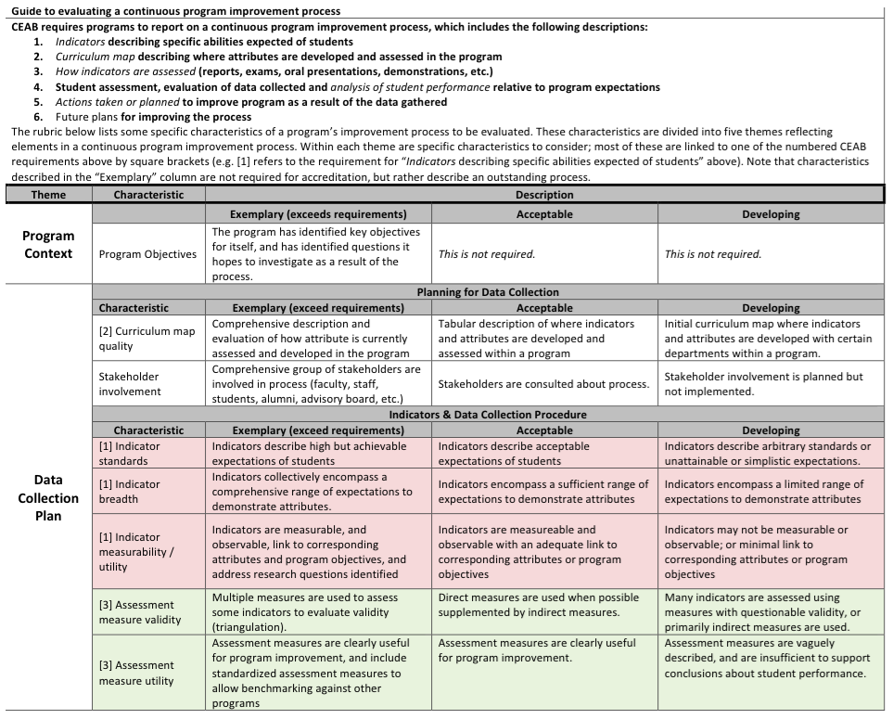

Slide 148
Banta’s characteristics of effective outcomes assessment
Planning
Implementation
C. Improving and sustaining
T. Banta (2002), Building Scholarship of Assessment. Jossey-Bass

Slide 149
Banta’s characteristics of effective outcomes assessment
A. Planning
1. Involve stakeholders from the outset
2. Begin when need is recognized, and allow sufficient time for development
3. Written plan with clear purposes related to goals that people value. Assessment is a vehicle for improvement.
4. Bases assessment on clear program outcomes
B. Implementation
C. Improving and sustaining
T. Banta (2002), Building Scholarship of Assessment. Jossey-Bass

Slide 150
Banta’s characteristics of effective outcomes assessment
Planning
Implementation
5. Knowledgeable, effective leadership
6. Recognizes that assessment is essential to learning, and everyone’s responsibility
7. Include faculty and staff development
8. Devolves responsibility for assessment to unit level.
9. Uses multiple measures, maximizing reliability and validity
10. Assesses both processes and outcomes.
11. Undertaken in an environment that is receptive, supporting, and enabling on a continuing basis.
12. Continuous communication with constituents about activities and findings.
C. Improving and sustaining
T. Banta (2002), Building Scholarship of Assessment. Jossey-Bass

Slide 151
Banta’s characteristics of effective outcomes assessment
Planning
Implementation
C. Improving and sustaining
13. Produces credible evidence of learning and organizational effectiveness.
14. Ensures assessment data is used continuously to improve programs and services.
15. Provides a vehicle or demonstrating accountability to stakeholders.
16. Encompasses expectation that outcomes assessment will be ongoing, not episodic.
17. Incorporates ongoing evaluation and improvement of assessment process.
T. Banta (2002), Building Scholarship of Assessment. Jossey-Bass

Slide 152
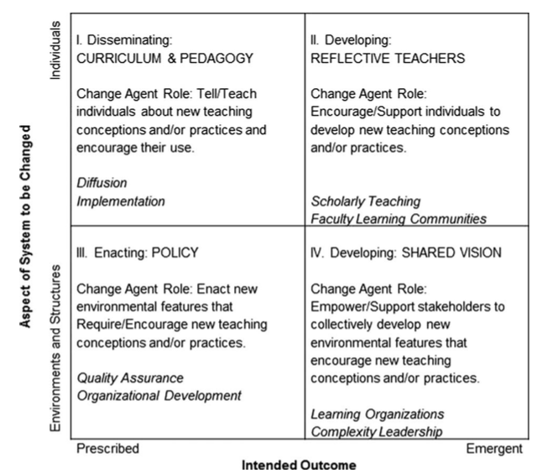
1. Borrego M, Henderson C. Increasing the Use of Evidence-Based Teaching in STEM Higher Education: A Comparison of Eight Change Strategies. J Eng Educ. 2014 Apr 1;103(2):220–52.

Slide 153
Change strategies
“The literature helps us understand that quality assurance in higher education should not be considered as a cutting-edge change strategy; rather, the approach is suited to bringing a large number of programs up to a minimum standard.”
1. Borrego M, Henderson C. Increasing the Use of Evidence-Based Teaching in STEM Higher Education: A Comparison of Eight Change Strategies. J Eng Educ. 2014 Apr 1;103(2):220–52.

Slide 154
Change strategies
“A good starting point, particularly for those without social science backgrounds, is to focus on one strategy that fits their situation best (in terms of resources, goals, locus of change, and implicit assumptions about change already being followed).”
“Over time and across initiatives, it is wise to employ a range of perspectives. Focusing too narrowly on one perspective increases the chances of overlooking influential factors and processes.”
1. Borrego M, Henderson C. Increasing the Use of Evidence-Based Teaching in STEM Higher Education: A Comparison of Eight Change Strategies. J Eng Educ. 2014 Apr 1;103(2):220–52.

Slide 155
Other questions
Communication plan – ensuring data goes back to instructors to improve the process
Software tools?
Responsibility for prompting, collecting, analyzing, and reporting?

Slide 156

Assessment for Course and Program Improvement
Brian Frank, Queen’s University
EGAD Project
Notes:
Thank you. Thanks to Kumi for organizing.
Enjoy coming to Vancouver - last time had a beautiful view of mountains. Would have been nice to see beyond the next building. Campus, website.
Looking forward to hearing other presenters and discussing efforts to improve engineering education. I doubt many of you get excited about graduate attribute reporting. However, I bet that you are interested in improving the quality of education, and that’s fundamentally what this is about. Thankfully, that’s exactly what we hear from schools across the country when we ask how they are approaching the requirements for outcomes assessment.
Most say that they view the accreditation process as a way to help assess and improve program quality. We have to do it, so let’s do it in a way that is useful, rather than simply trying to tick boxes for an accreditation visit.
I read that your motto here at BCIT translates to "To each their highest attainment”- I like that, and hope that translating that to action can be a goal of the symposium.

Slide 157
Example: First year design course

Slide 158
First year design
course project
rubric

Slide 160
What to look for in assessment tools
Workload: Results in a feasible workload for students and graders
Generalizability: Results are representative of entire program/class
Content: The assessment tool is clearly aligned with the outcome
Reliability: Results will be consistent between graders, or if tested again
Actionable: Provides useful information related to educational experience that can be used for course and/or program improvement

Slide 161
Priority 1: Resources
First year
Aggregating
Second year
Third year
Fourth year
Notes:
Open source software, R Project.

Slide 162
Priority 1: Resources
By indicator

Slide 163
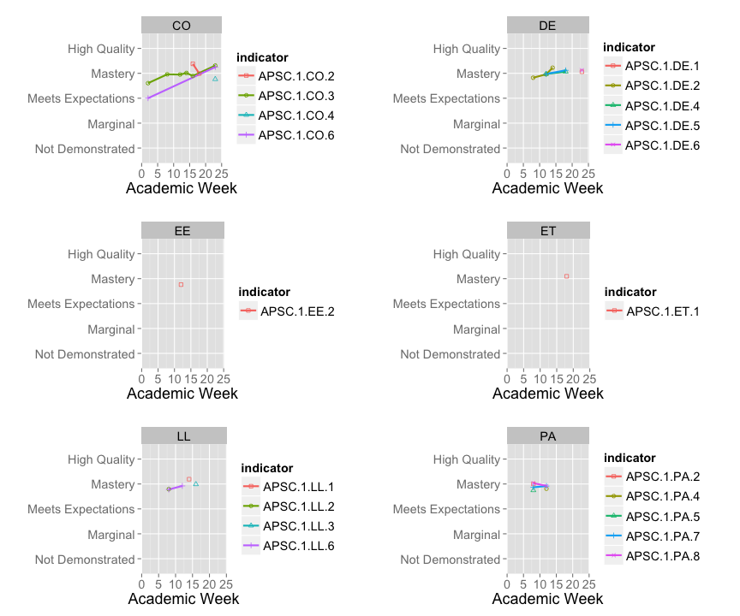
Over time

Slide 164
Multiple years

Slide 166
Triangulation: Can we trust the data?
Standardized
Measurement
Collegiate Learning Assessment (CLA+)
Critical Thinking Assessment Test (CAT)
Transferable Learning Orientations Survey (TLO)
Qualitative
Performance
Evaluation
Course Embedded Measures
Team observations to see the students’ intellectual skill development
Valid Assessment of Learning in Undergraduate Education (VALUE) rubrics for evaluation of course work

Slide 167
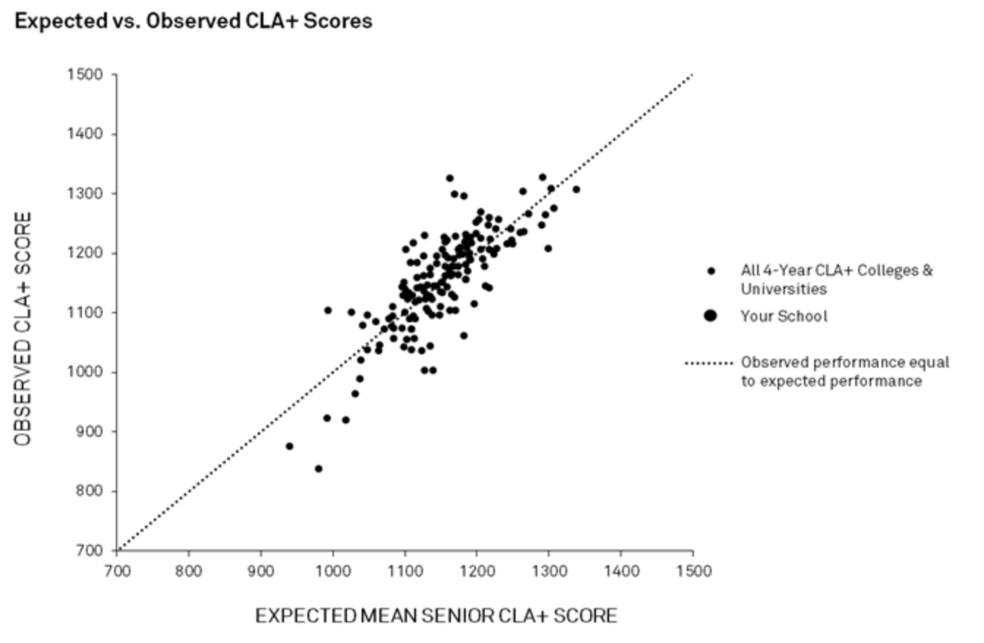
Collegiate Learning Assessment (CLA+)
Standardized instrument of Critical thinking & written communication
All 4-Year Colleges
1st Year (μ=1150)
4th Year (μ=1263)

Slide 168
Triangulation: Standard instrument and program-wide rubric
Analysis and Problem Solving
Identify Strategies
CLA+ Sub-scores
VALUE Rubric Dimensions
Evaluate Solutions
Writing Effectiveness
Evaluate Outcomes
Evidence
Writing Mechanics
Student’s Position
Critical Reading and Evaluation
Syntax and Mechanics
Key: Two courses p< .05
One course p< .01
Note: Correlations for one course at the p<.05 level not displayed

Slide 169

Code for analyzing data
All the plots using our data were generated using relatively few lines of code using R Project, an open source statistical computing package.
Code will be available on EGAD webpage

Slide 170
Using data for program improvement

Slide 171
Program improvement process

Slide 172
Other slides

Slide 173
HEQCO project objectives:
1
Provide useful information to improve learning
Scalable to entire university
Sustainable long term without external funding
Minimize additional workload on faculty, staff, and students

Slide 174
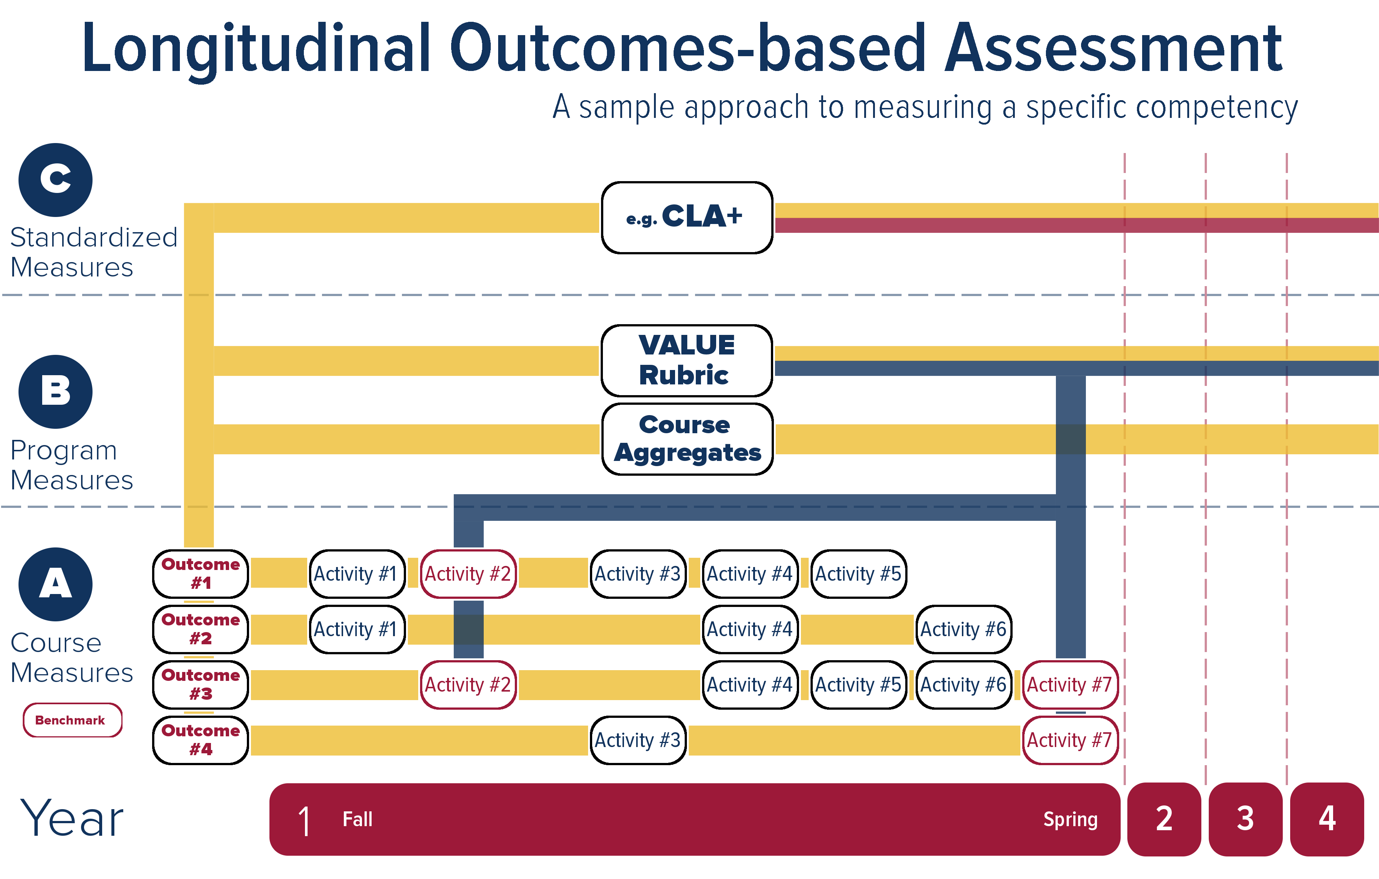
1

Slide 175
Outcomes assessment plan over three years
1
Outcome | Course specific rubrics | Standard test | VALUE rubric
Critical thinking | If available | CLA+ | Critical thinking
Problem solving | If available | CLA+ | Problem solving
Written comm. | If available | CLA+ | Written comm.
Lifelong learning | If available | Locally developed from MSLQ | Lifelong learn

Slide 176
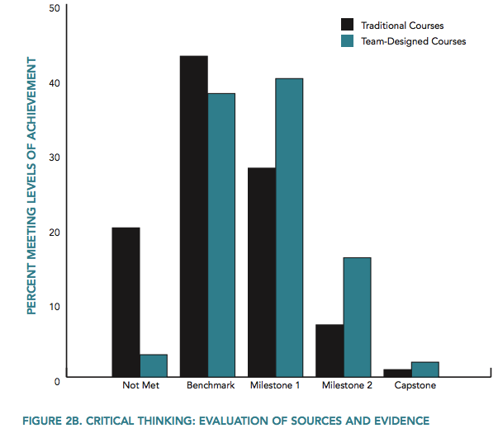
Assessing development using VALUE rubrics
A. Greenhoot, D. Benstein, Using VALUE Rubrics to Evaluate Collaborative Course Design, Peer Review, vol. 13 no. 4, AAC&U

Slide 177
Engineering Graduate Attribute Development (EGAD) Project
WHO
Engineering educators and educational developers across Canada (~10 people)
MANDATE
Supported by national deans council and CEAB
Collect and develop resources and training
Run annual national workshops, and customized institutional workshops
Pilot and report on processes

Slide 178
EGAD Workshops
Introduction to Continuous Program Improvement Processes
Creating Useful Learning Outcomes
What to Look for in an Outcomes-Based Process
Leading a program improvement process
Assessment for Course and Program Improvement (this afternoon)
Notes:
Broadened our workshop offerings

Slide 179
